Slide 1
Example Demodocus Workflow Medium-Fidelity Mockups
The Demodocus Team
September 30, 2020
© 2020 THE MITRE CORPORATION. ALL RIGHTS RESERVED.

Slide 2
Starting an Analysis
© 2020 THE MITRE CORPORATION. ALL RIGHTS RESERVED.

Slide 3
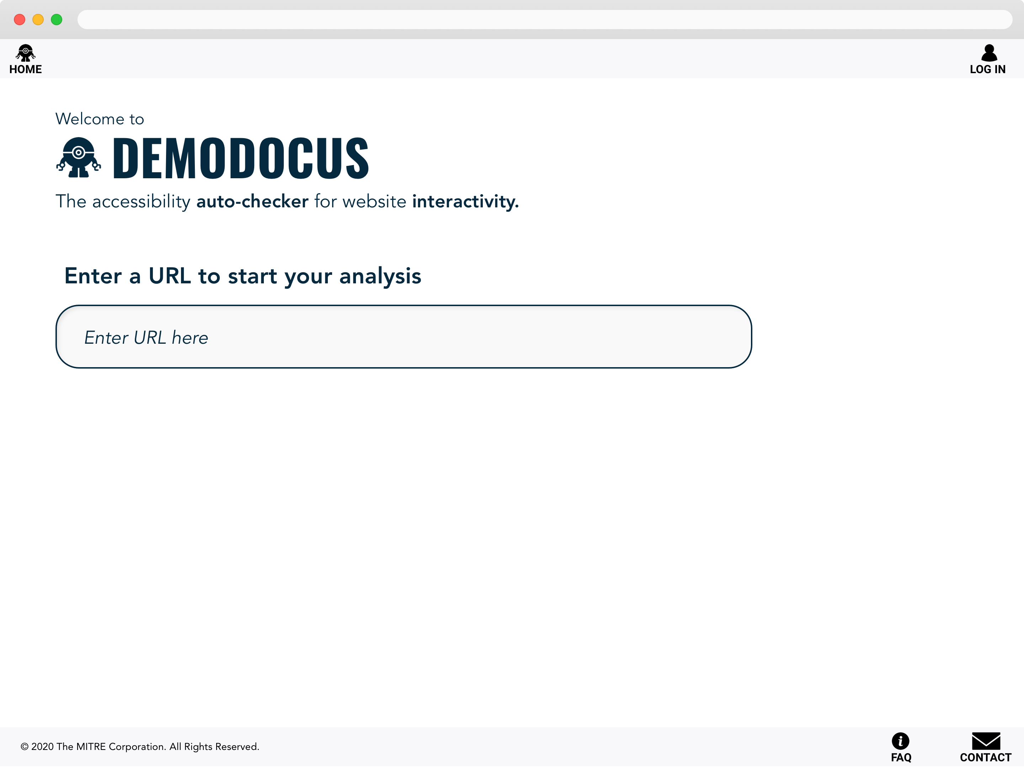

Slide 4
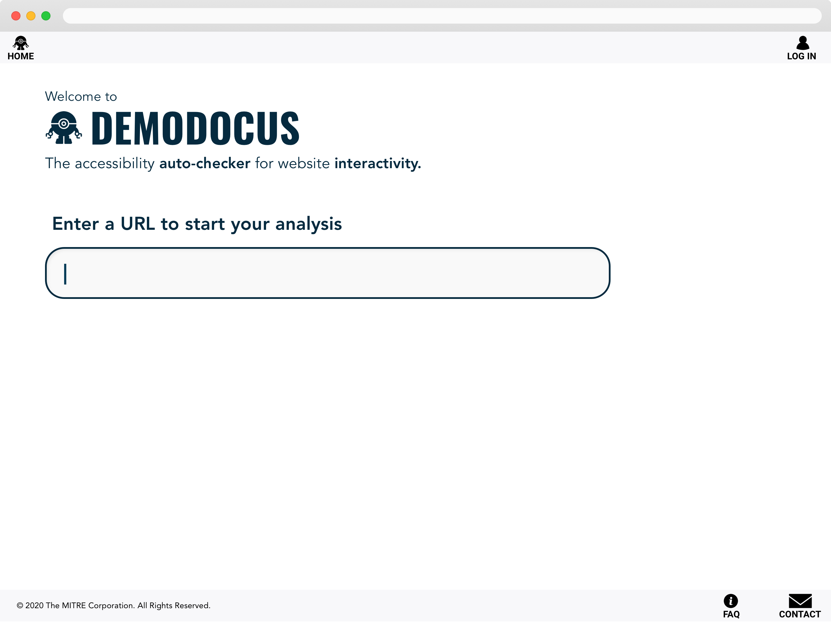

Slide 5
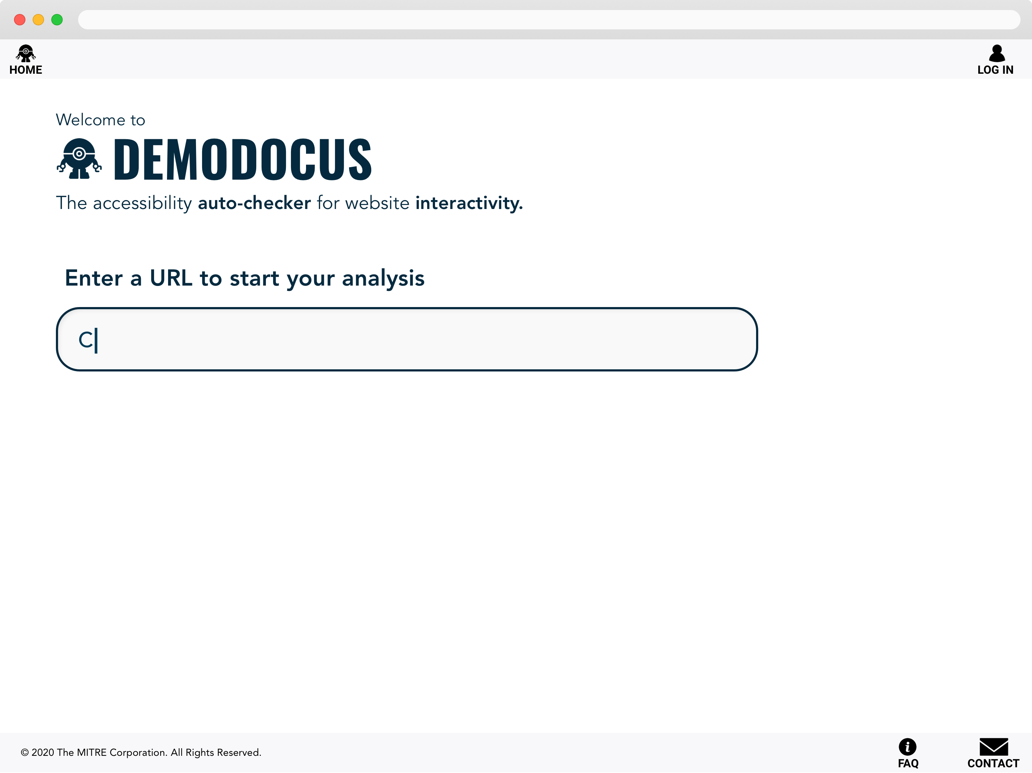

Slide 6
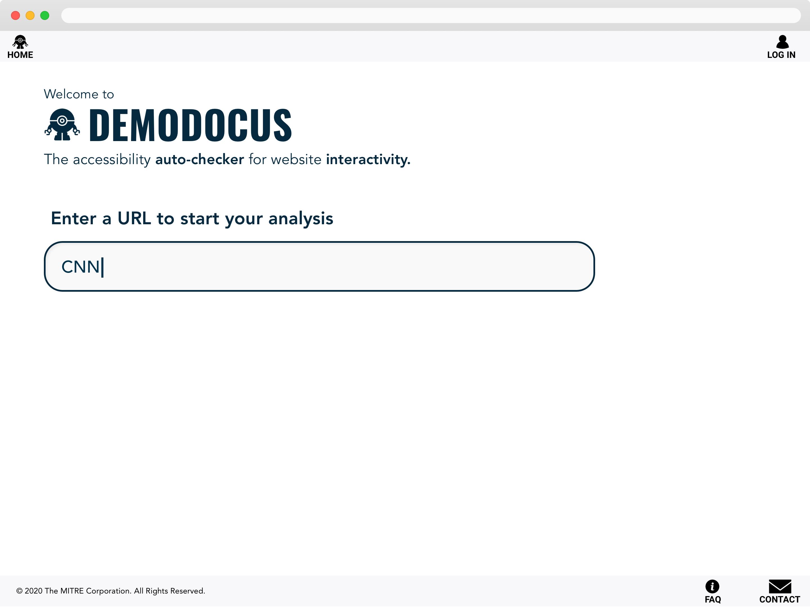

Slide 7
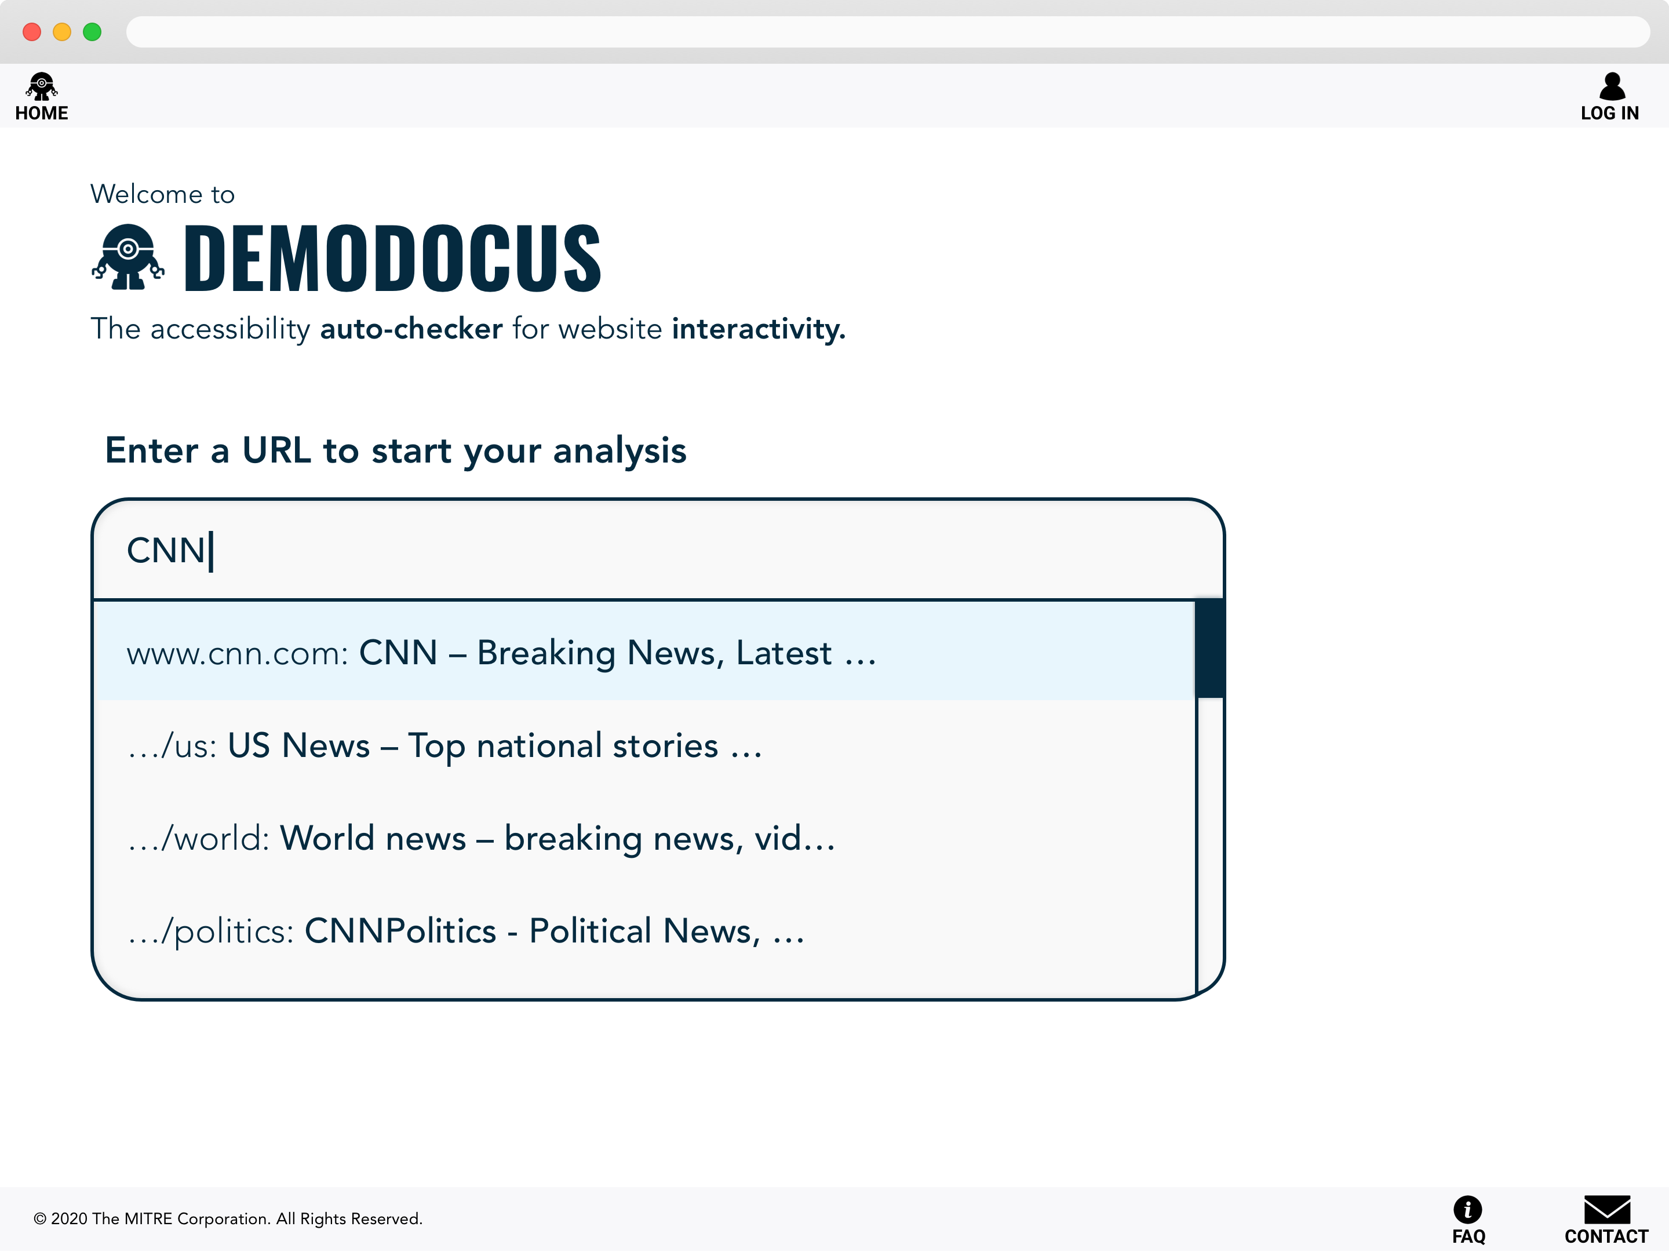

Slide 8
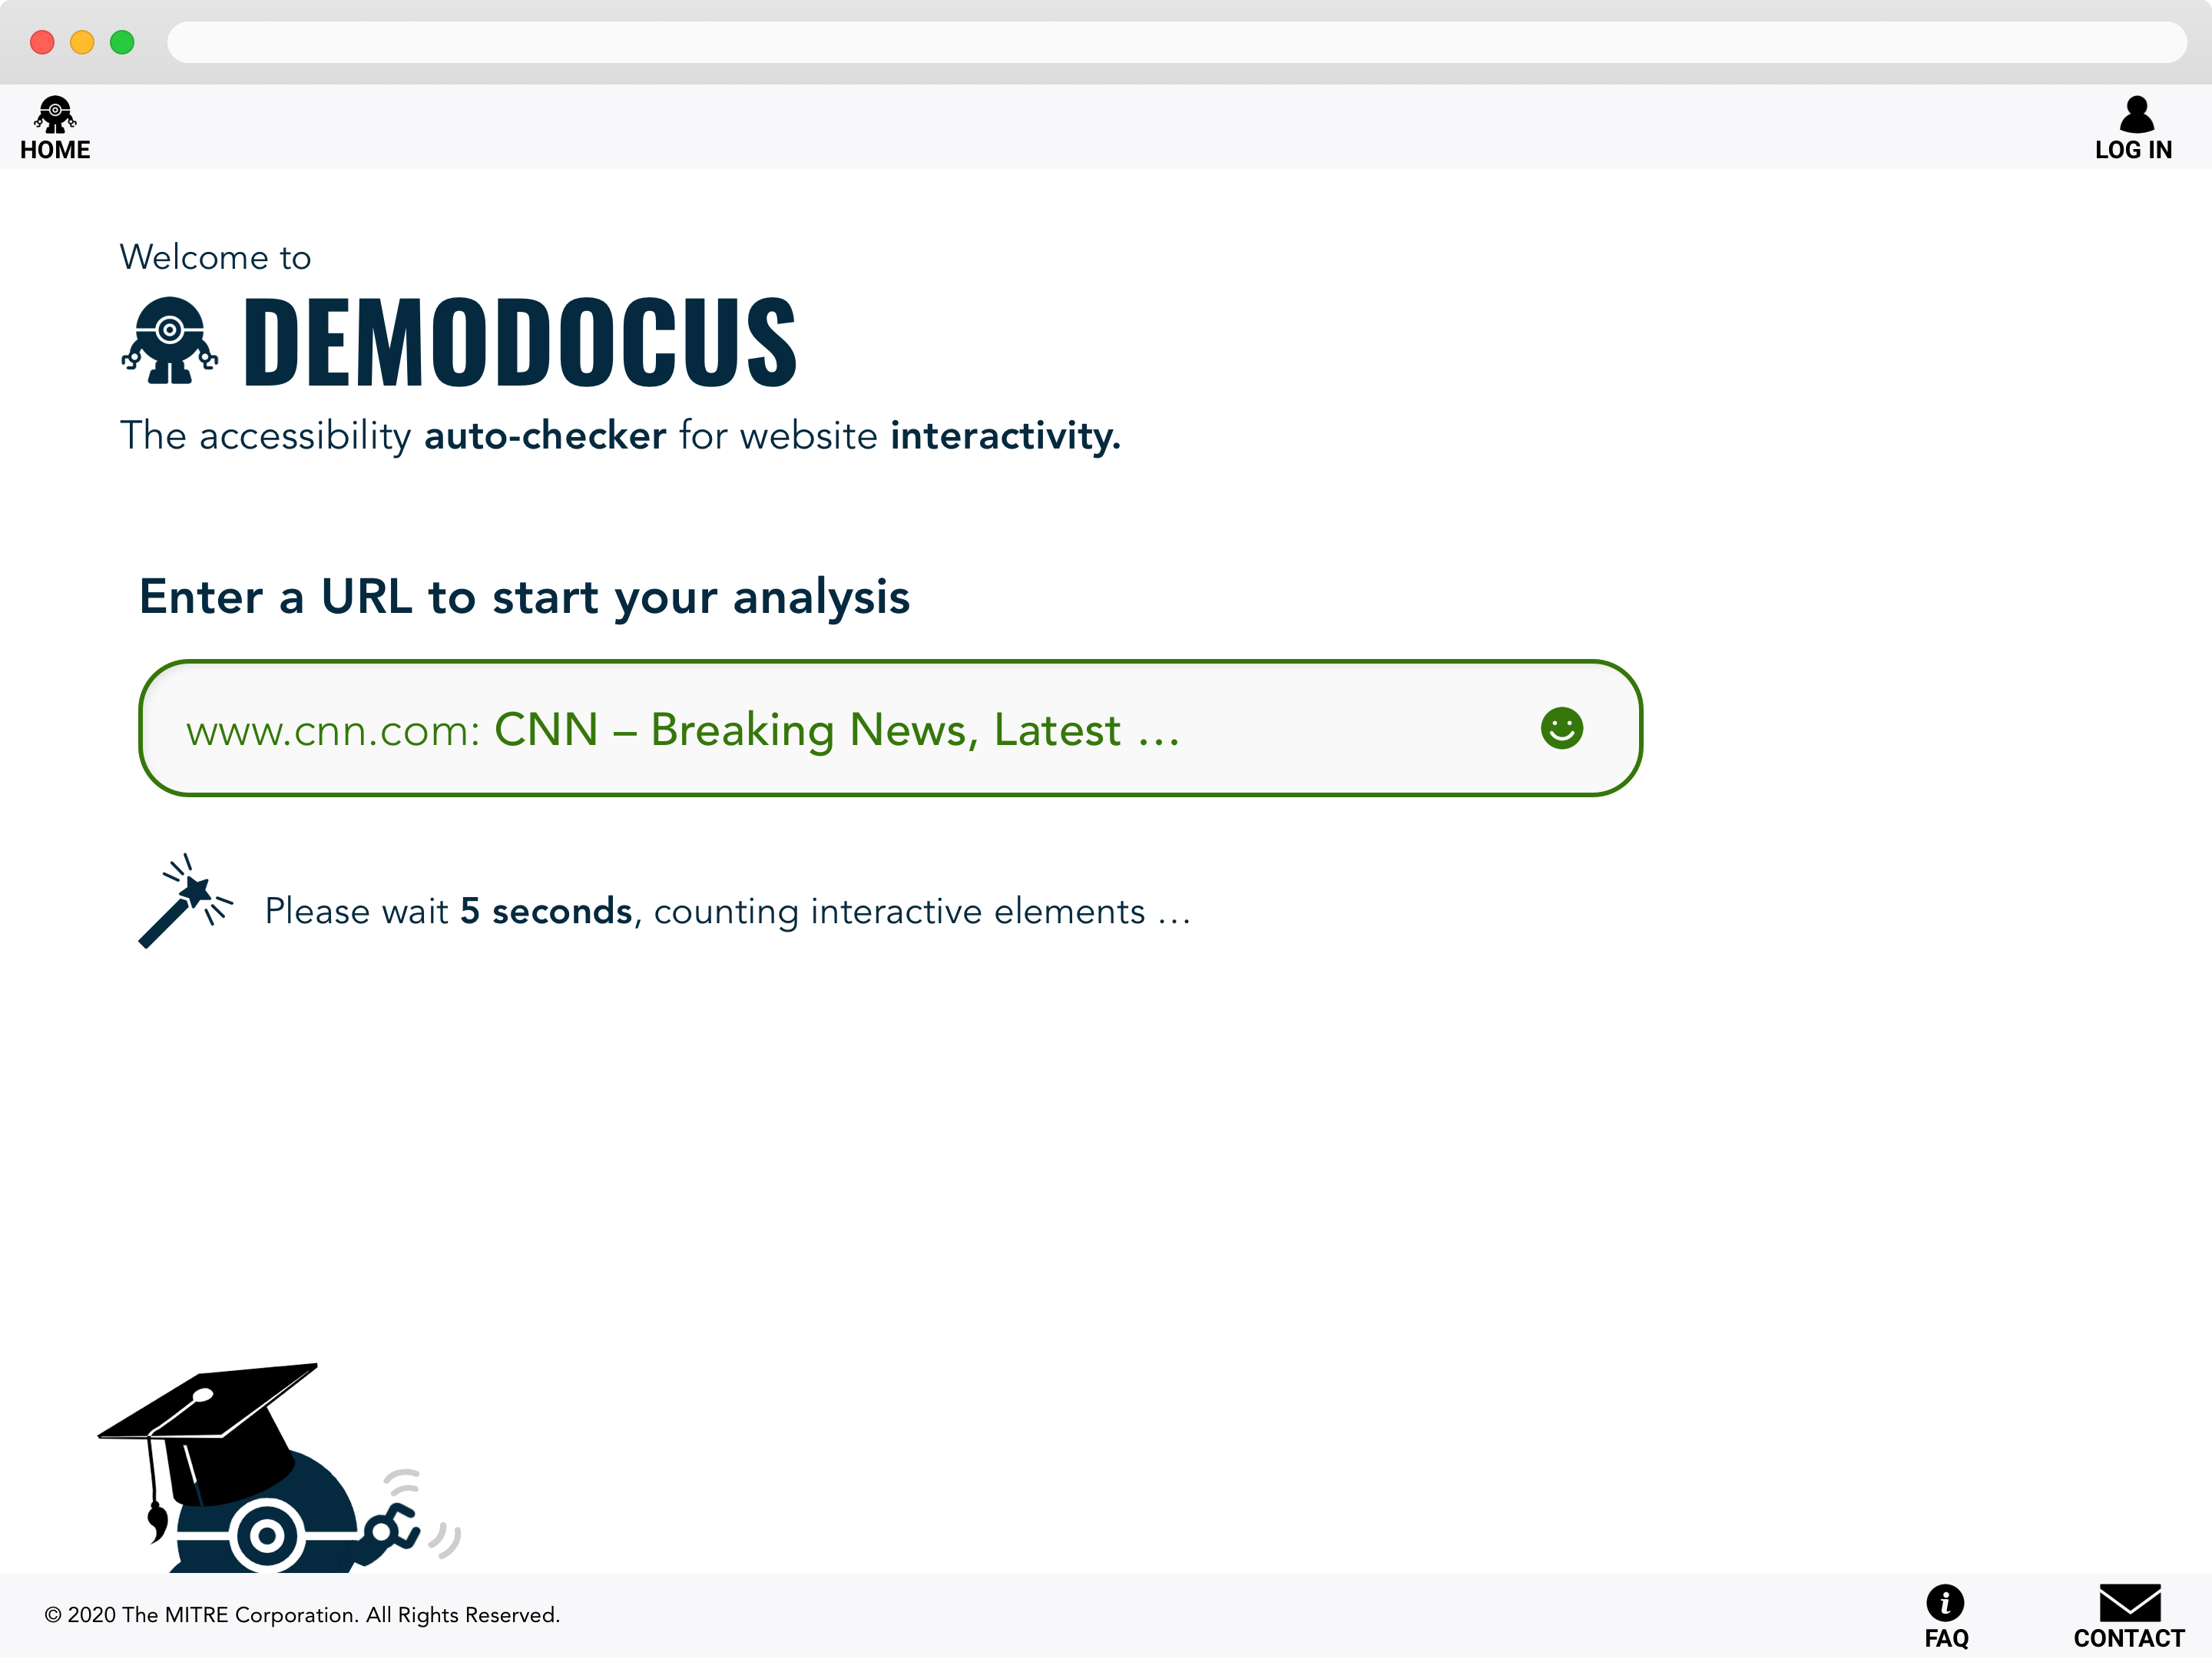

Slide 9
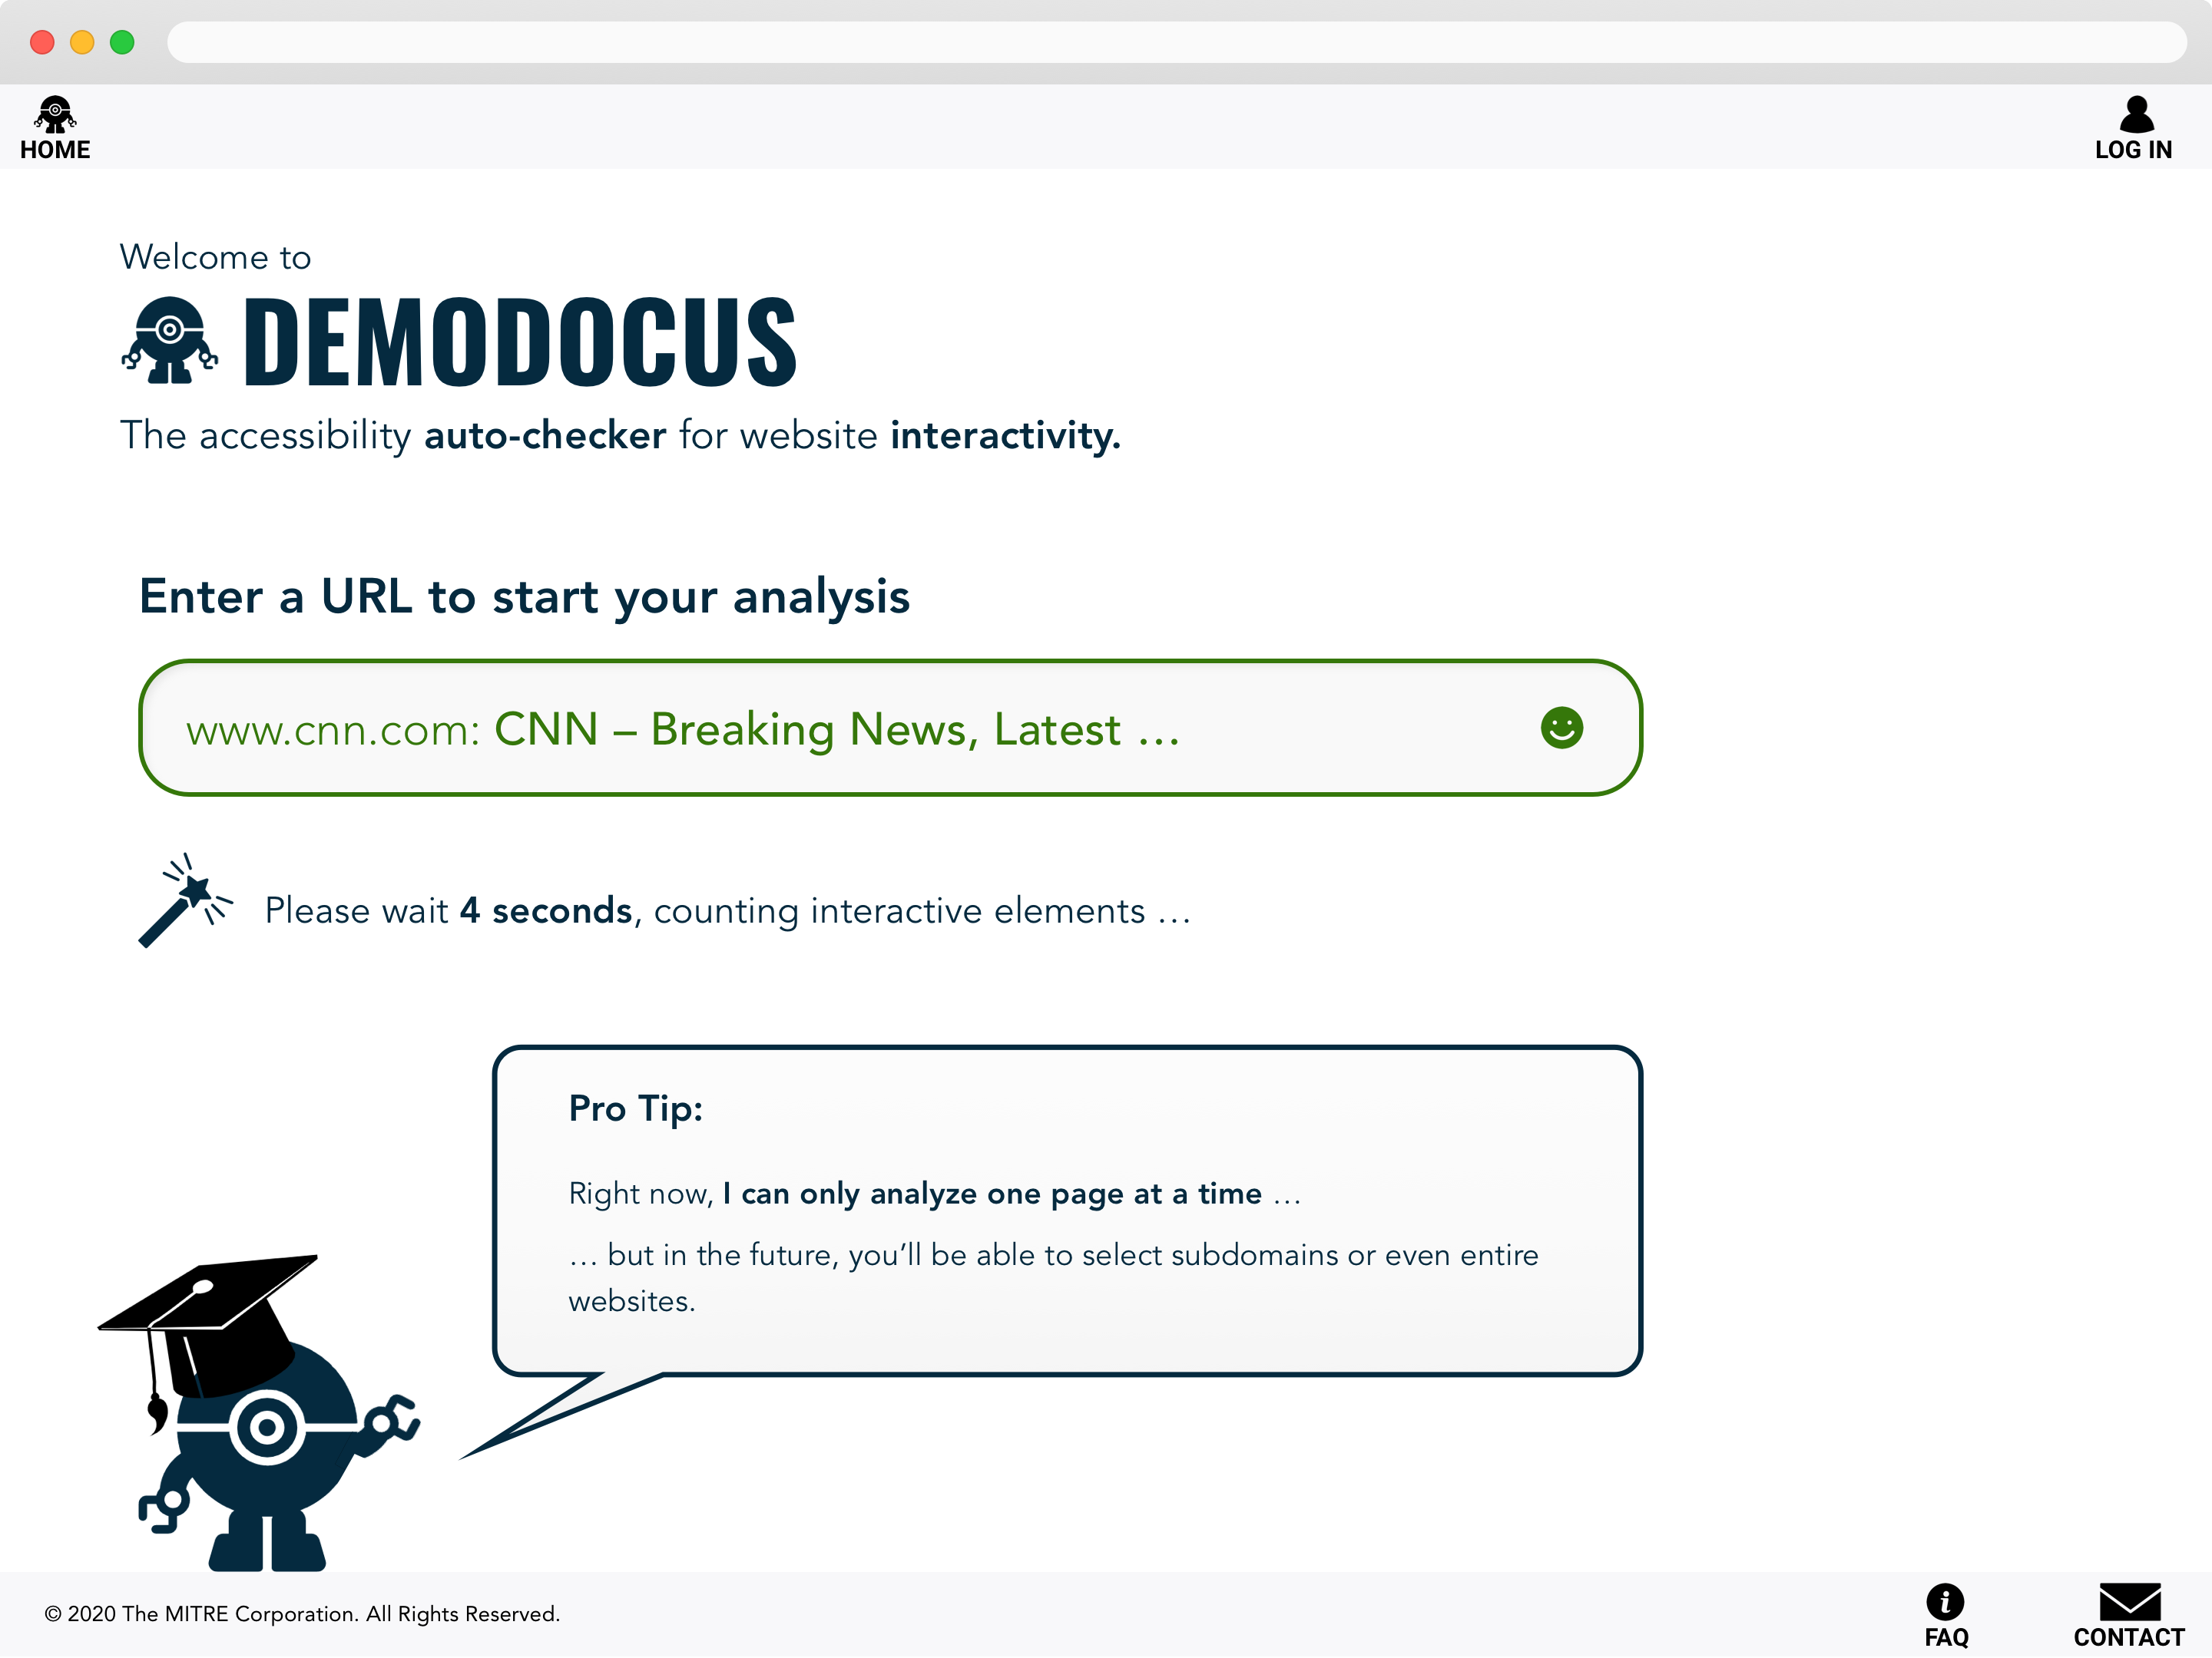

Slide 10
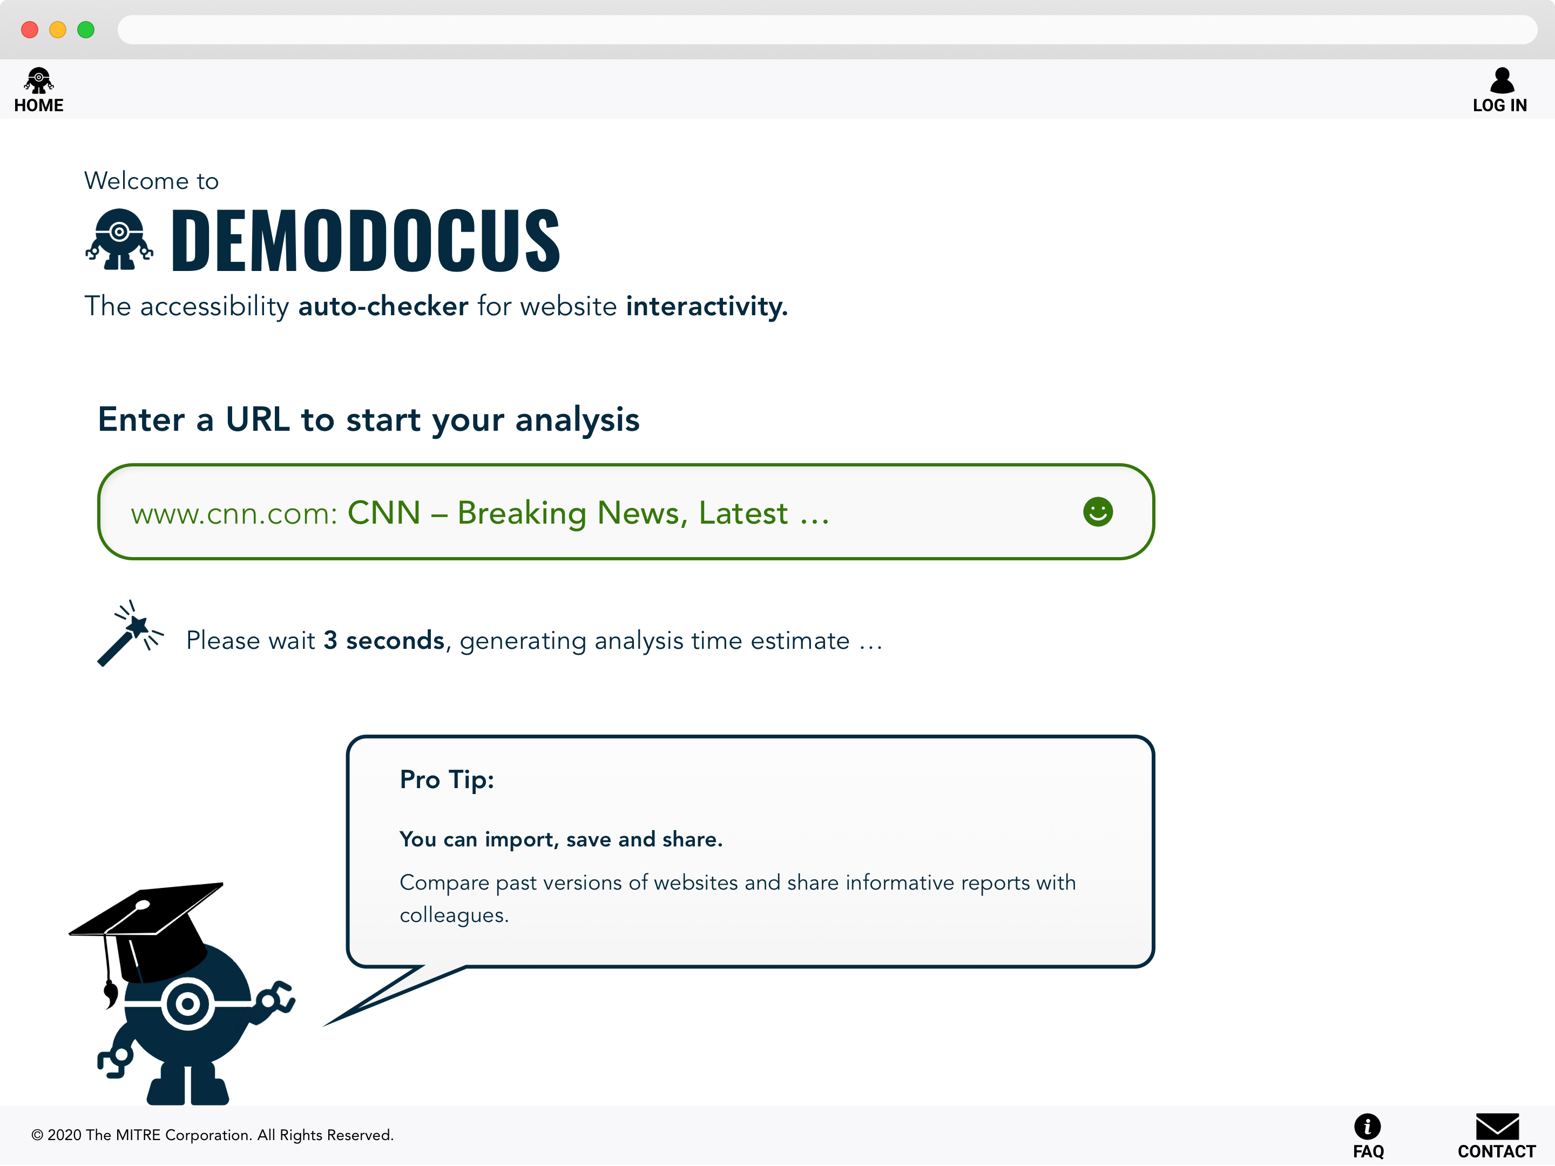

Slide 11
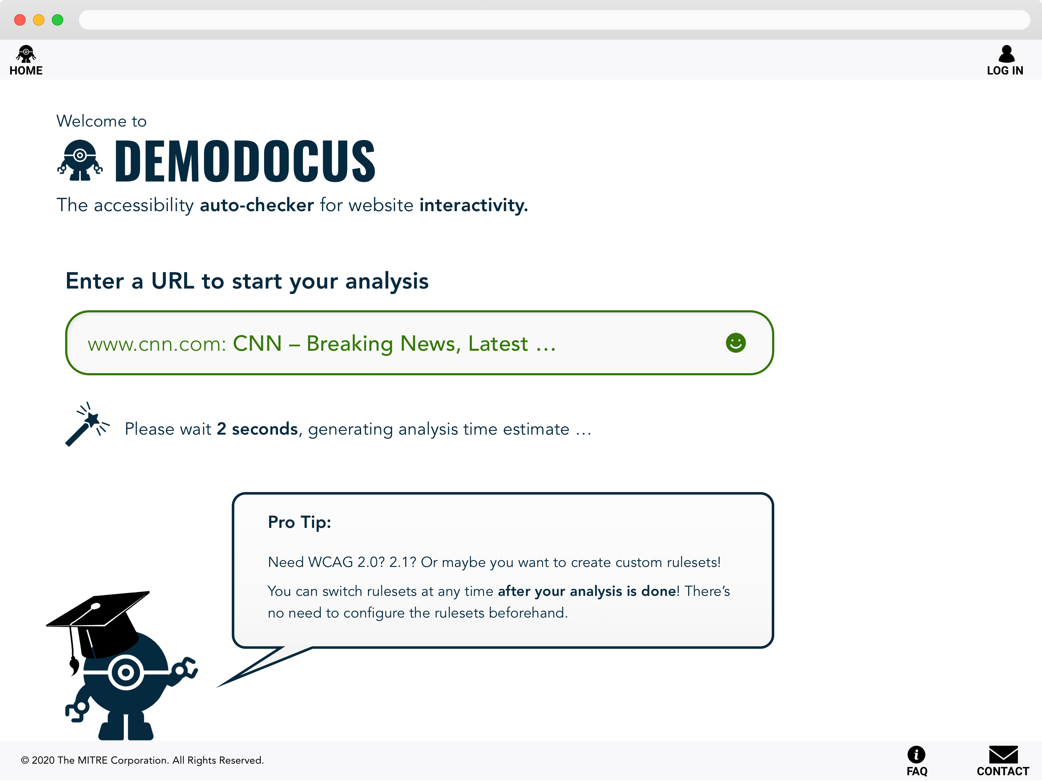

Slide 12
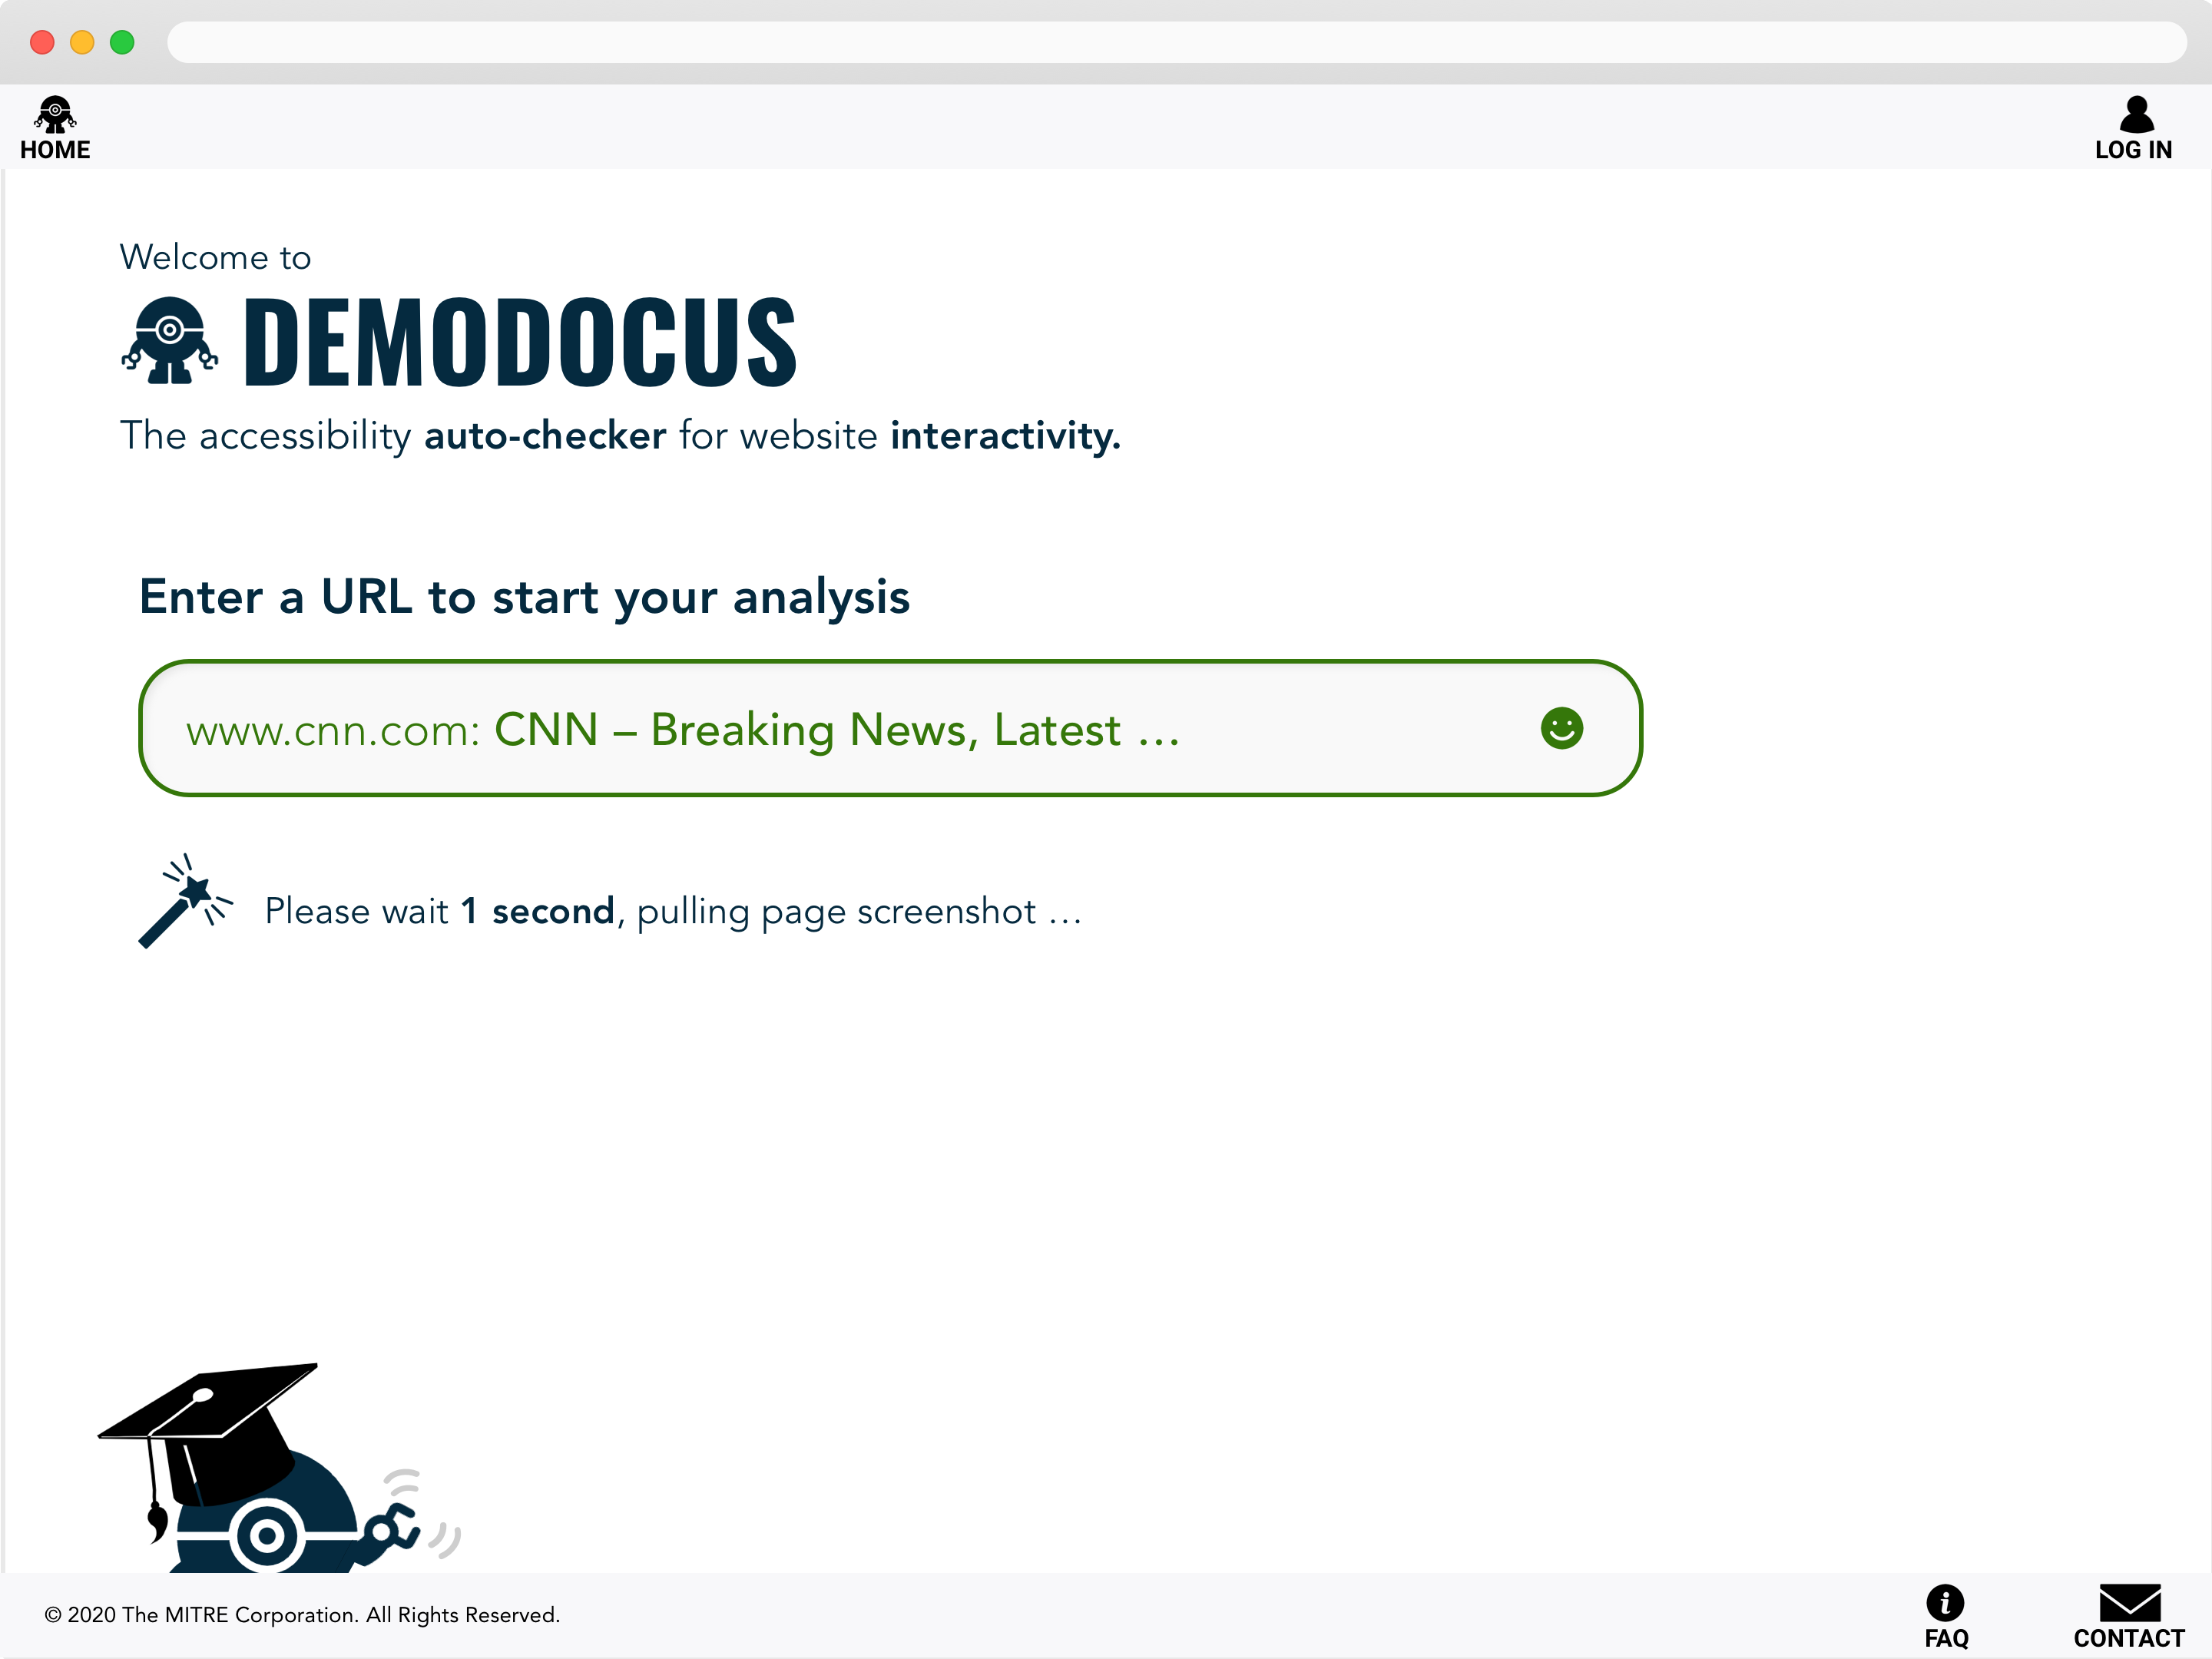

Slide 13
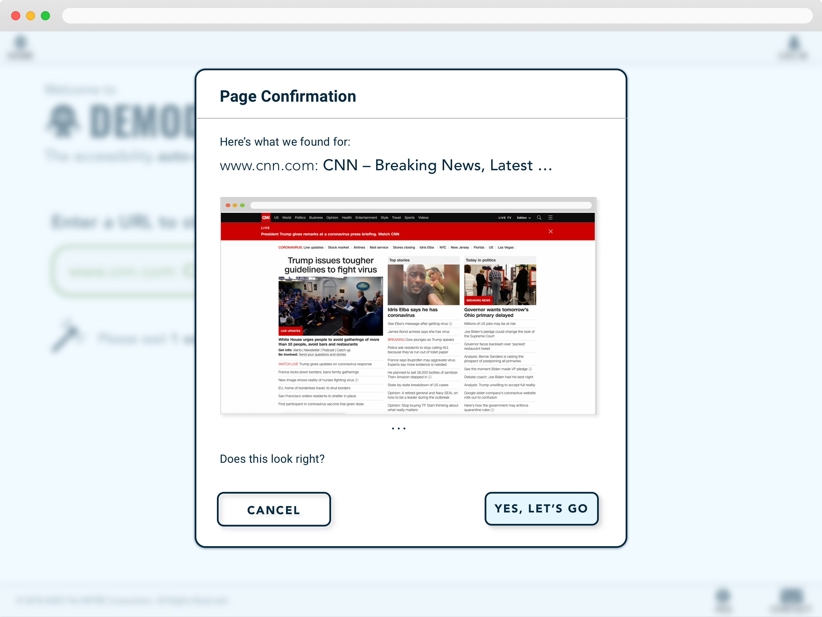

Slide 14
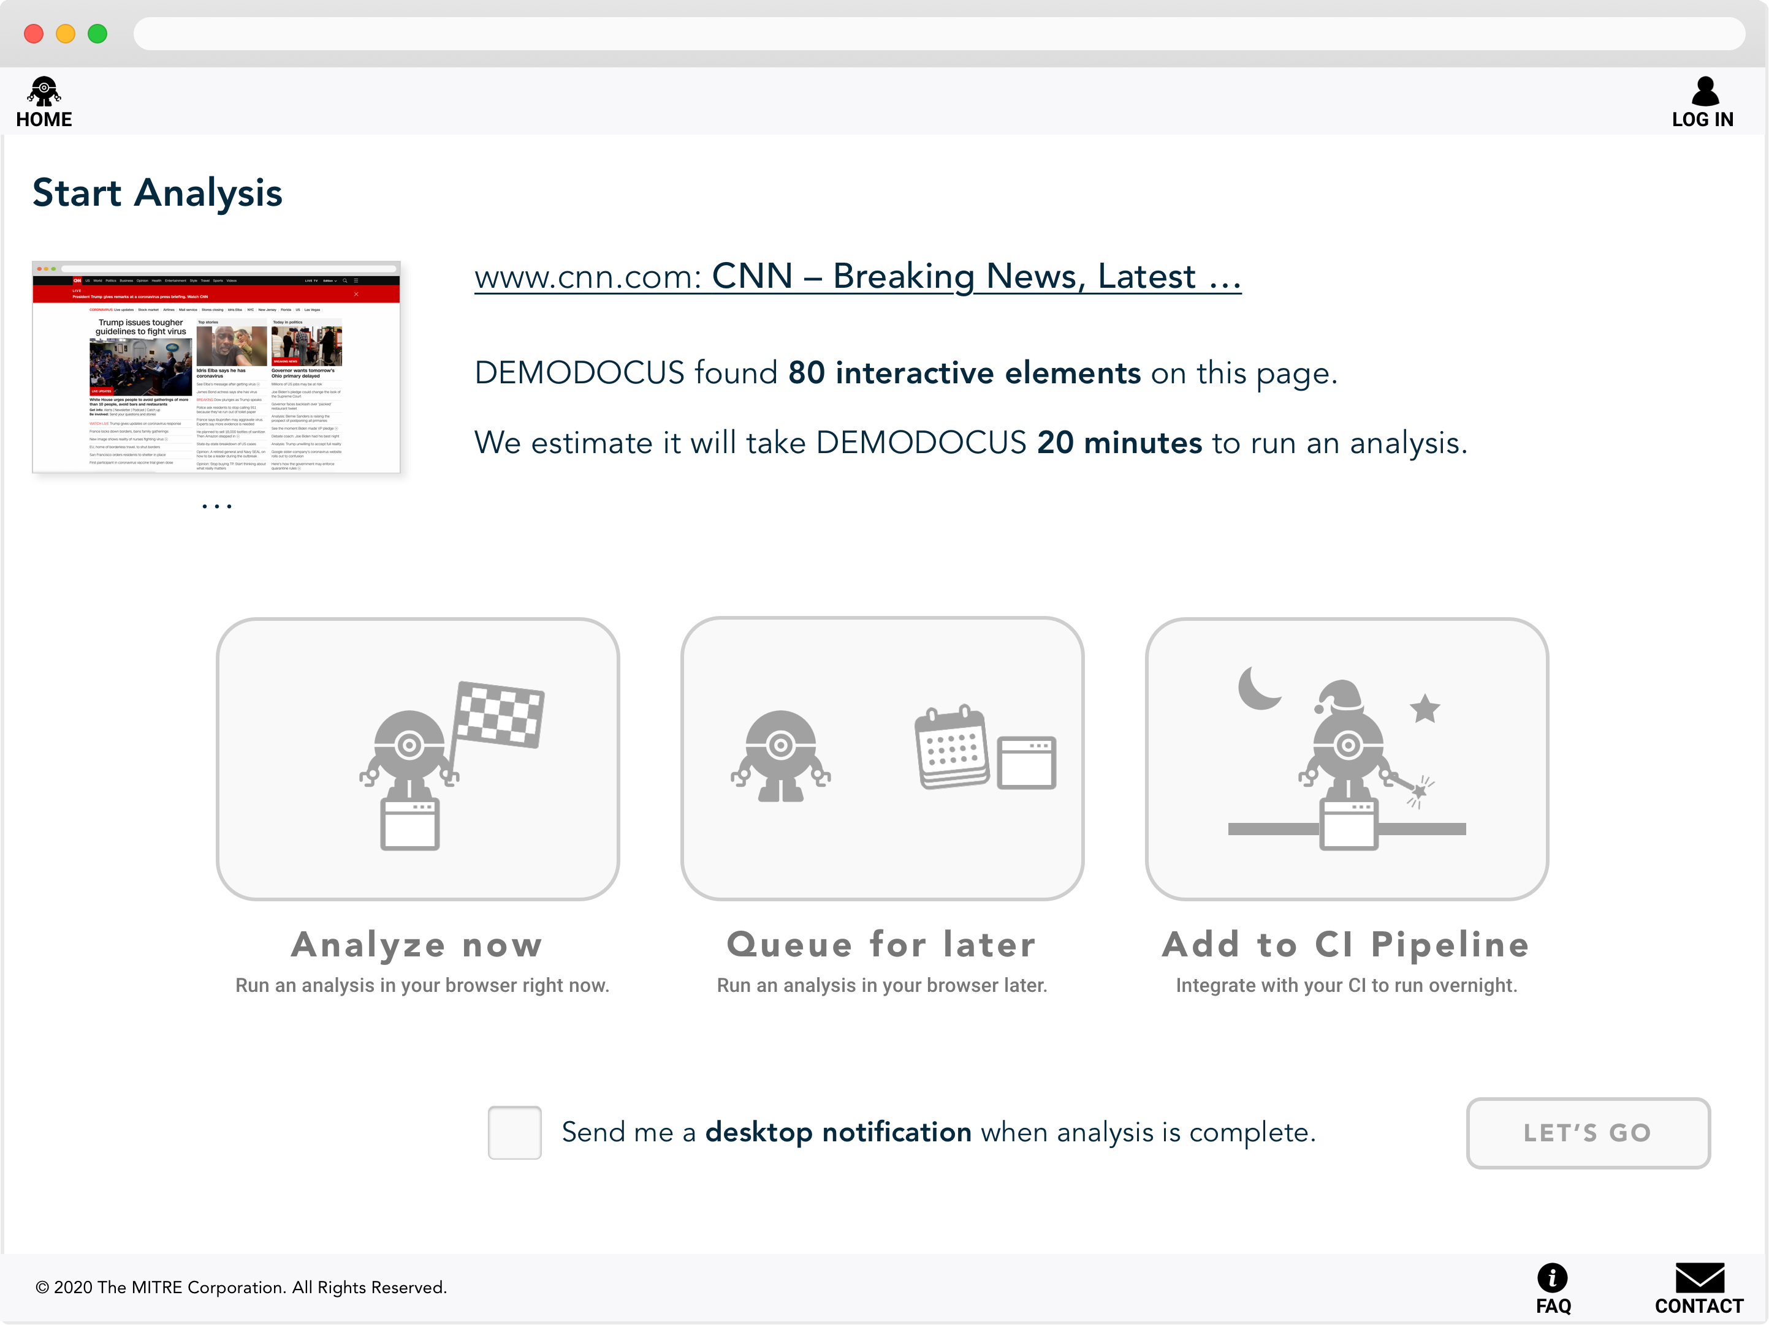

Slide 15
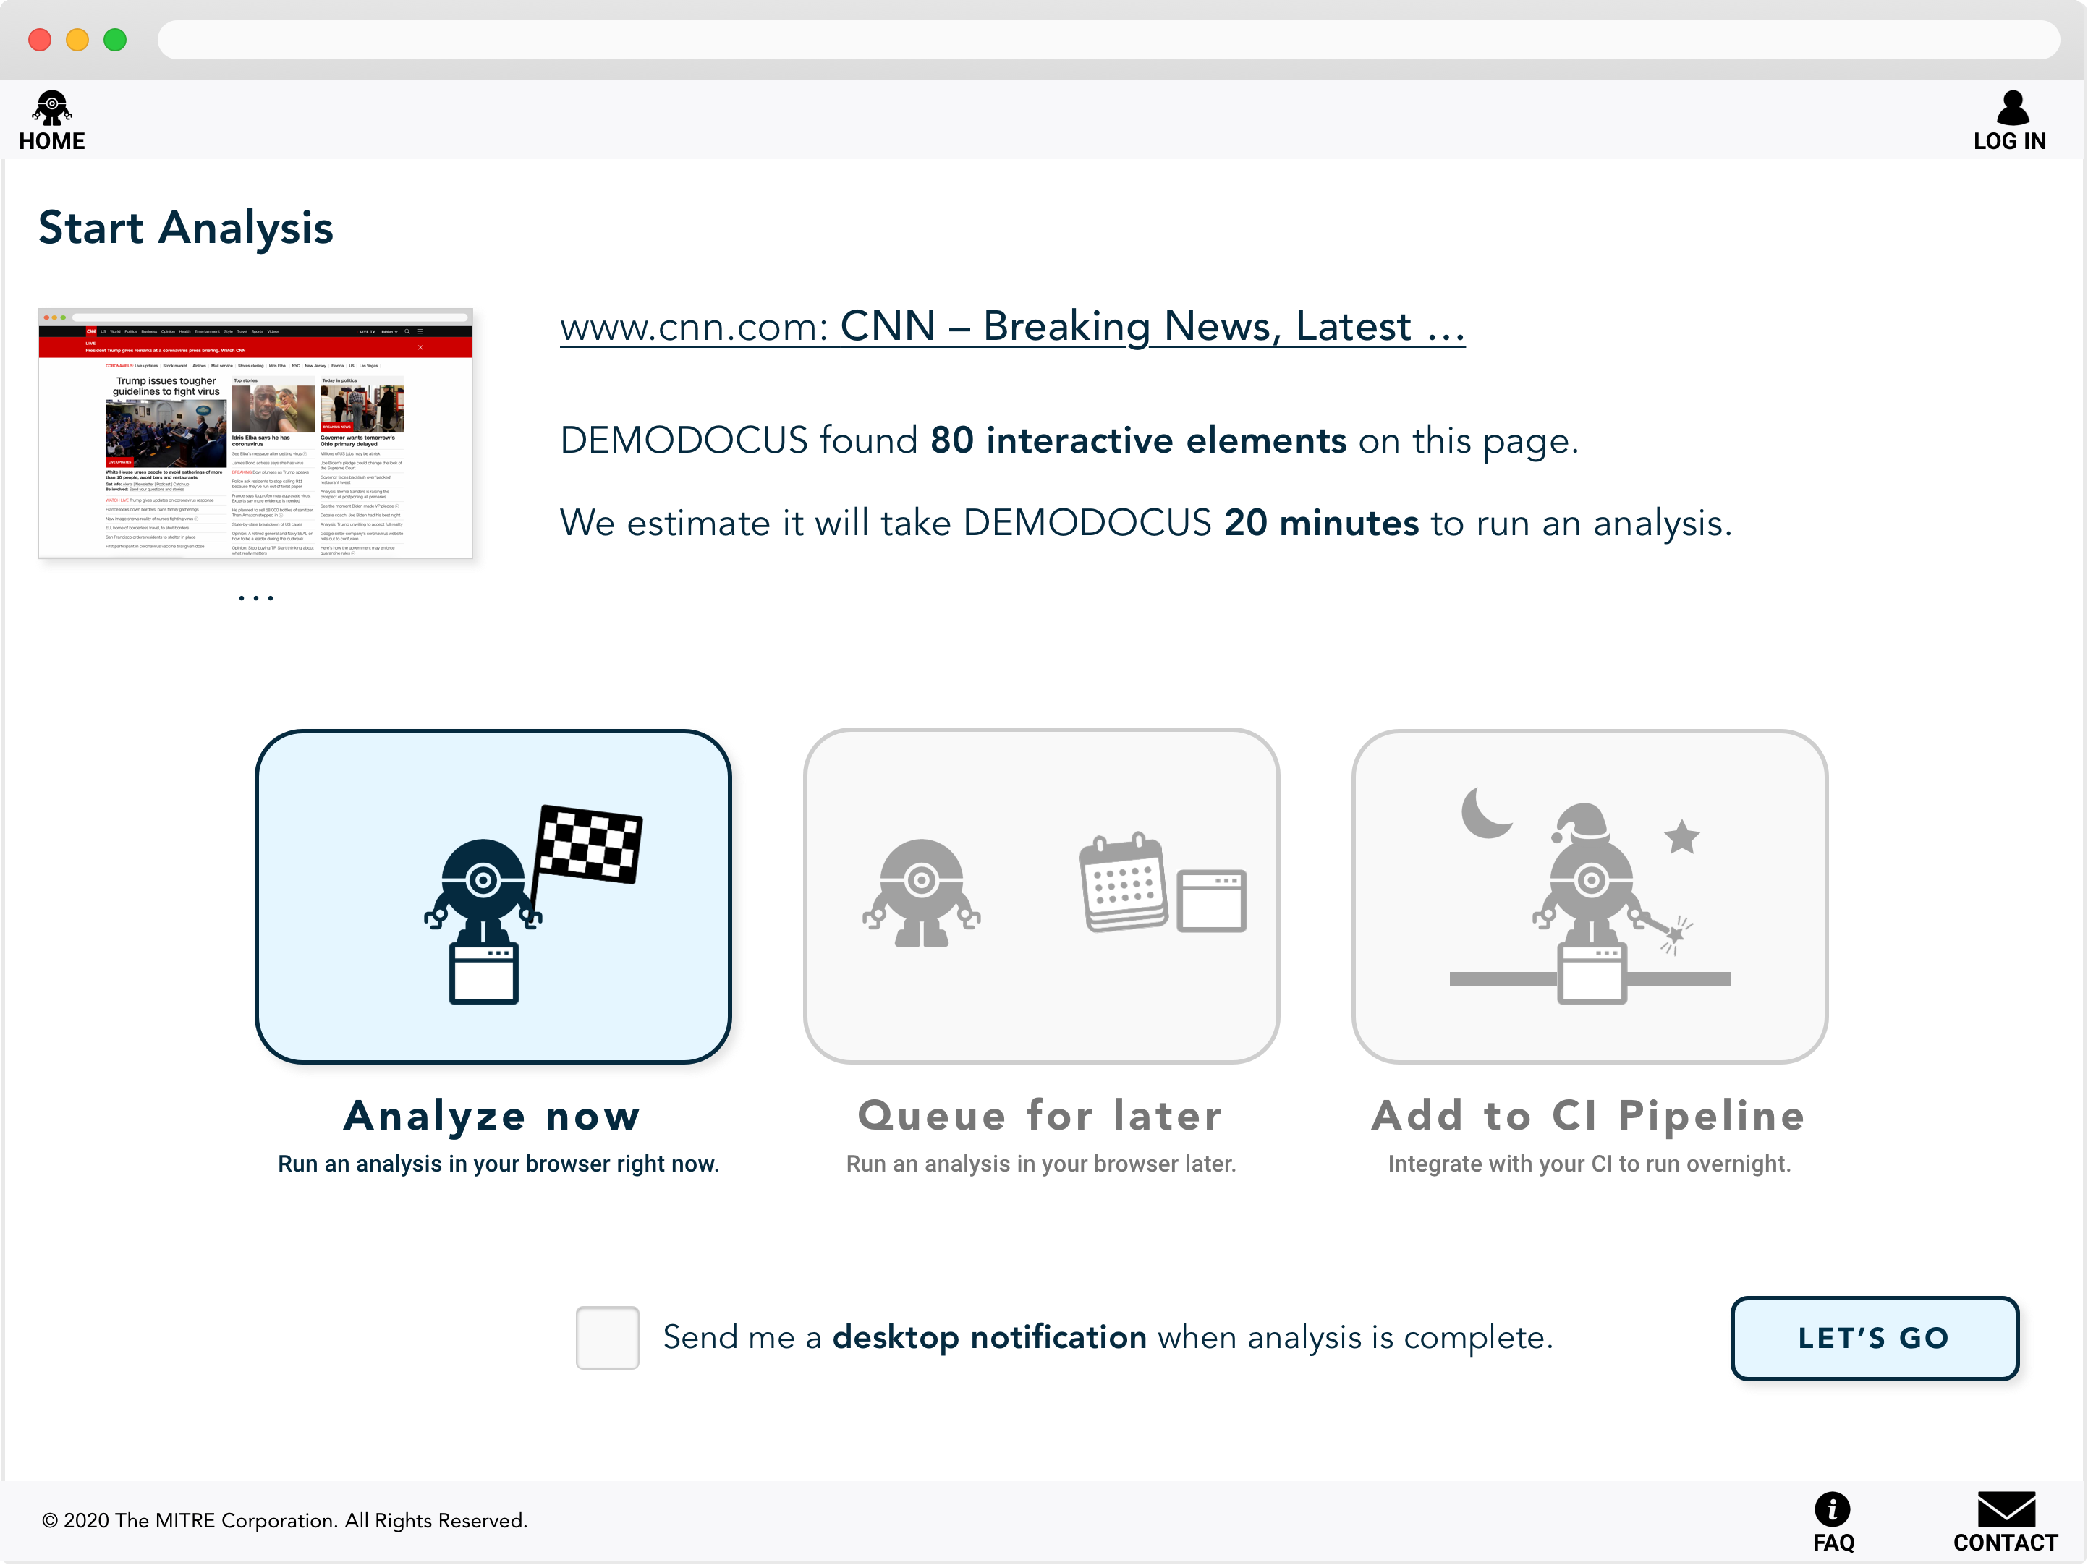

Slide 16
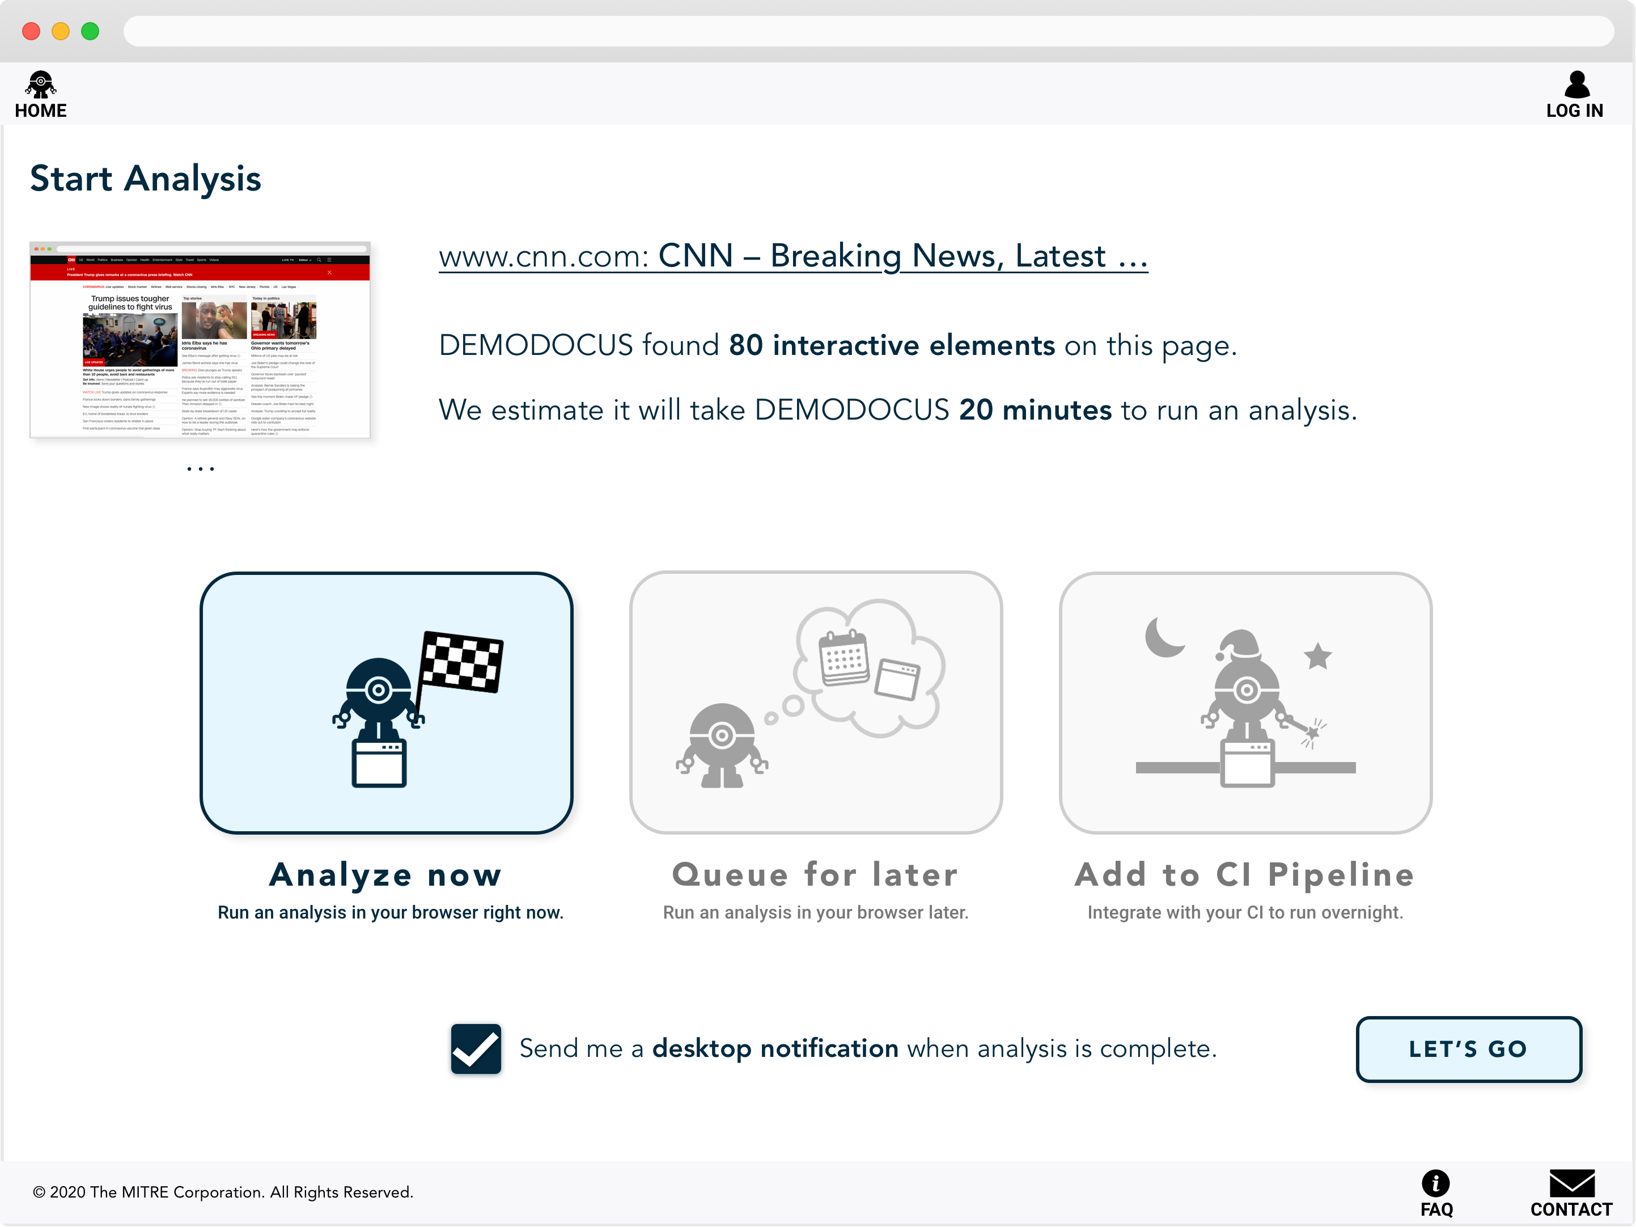

Slide 18


Slide 19
Viewing the Dashboard
© 2020 THE MITRE CORPORATION. ALL RIGHTS RESERVED.

Slide 20
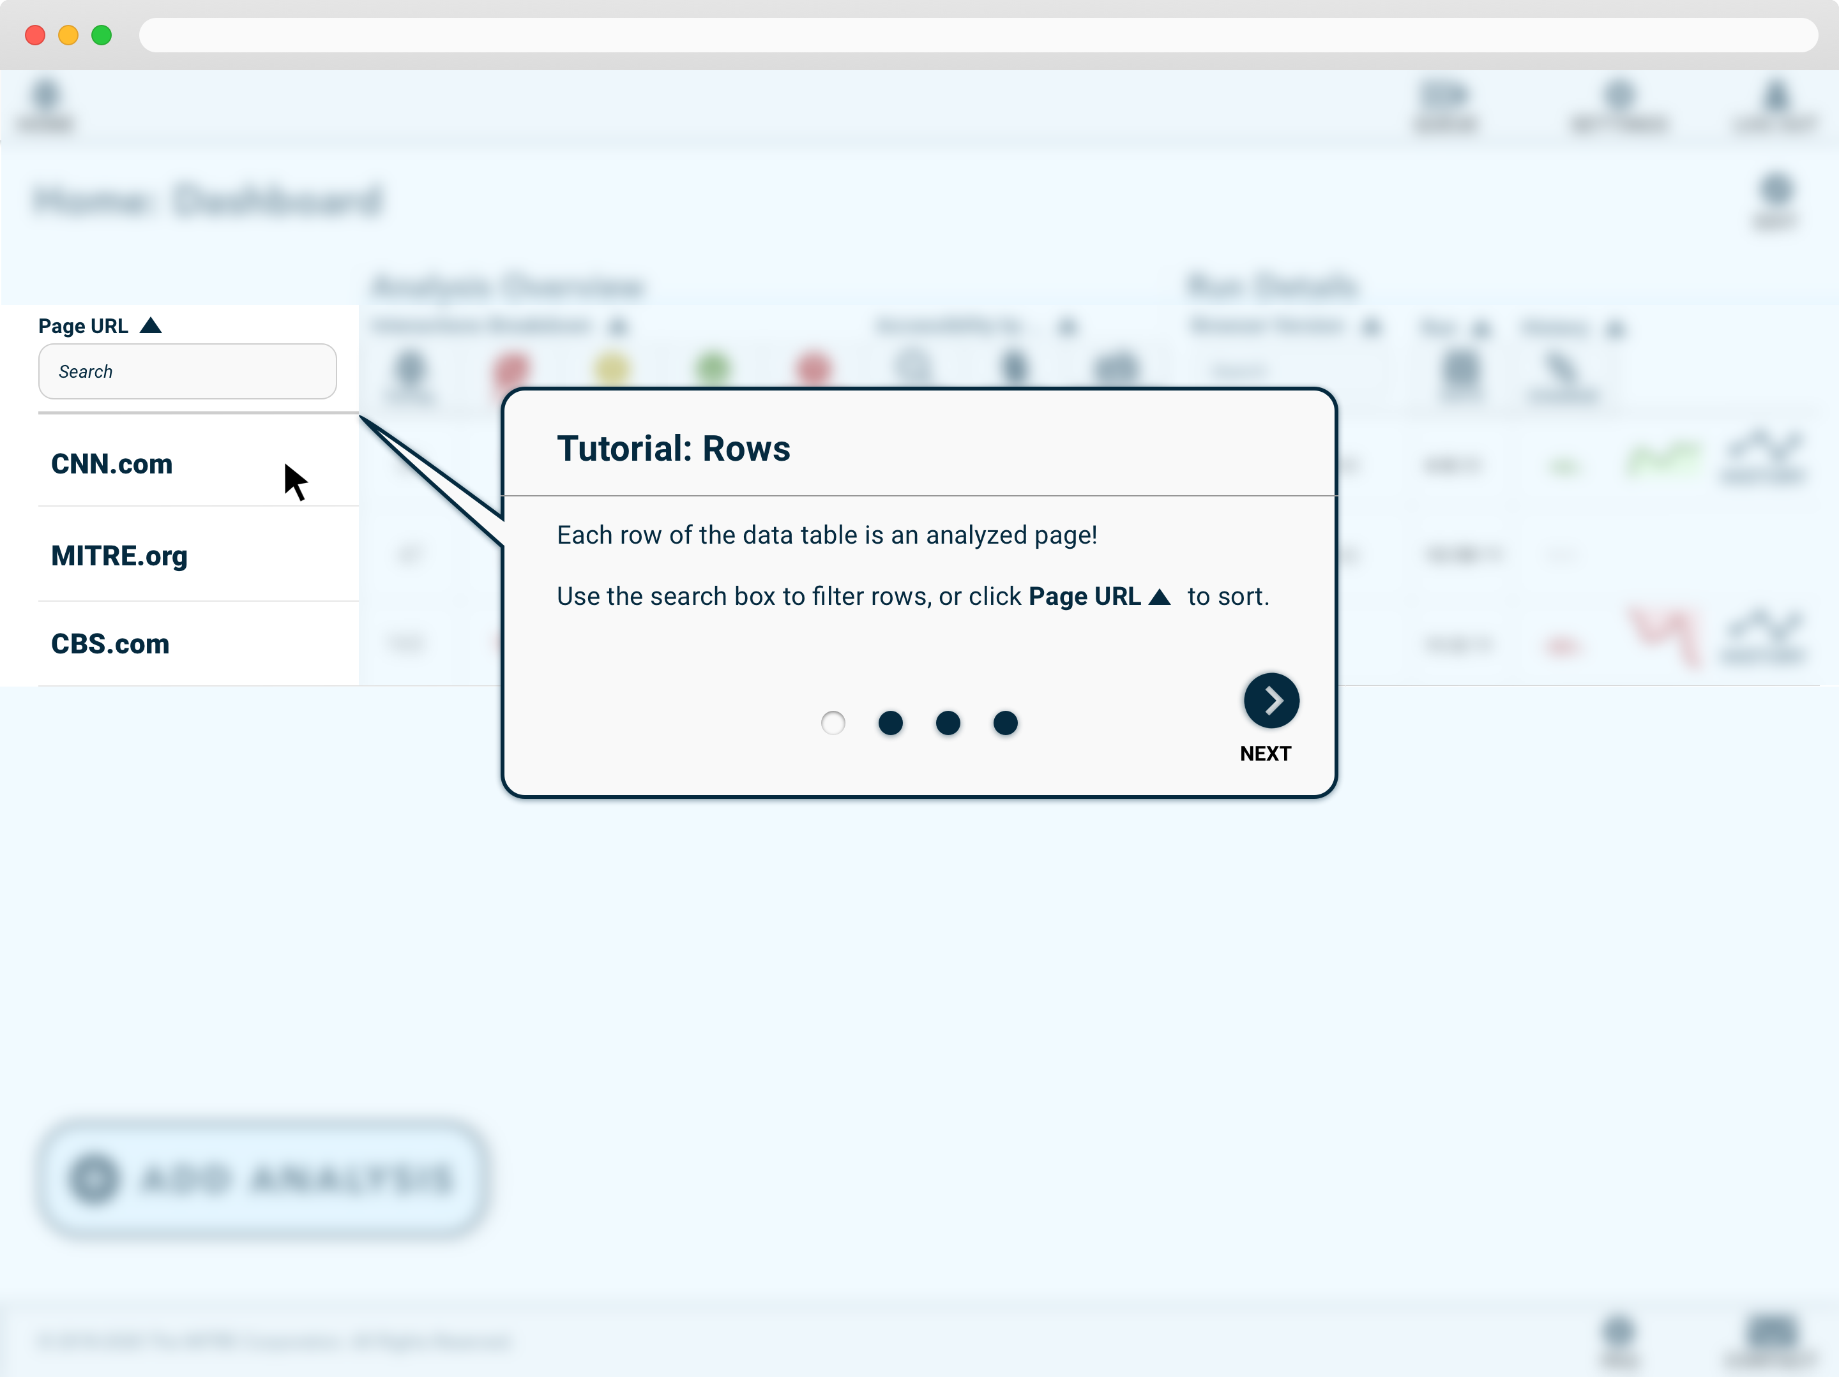

Slide 21
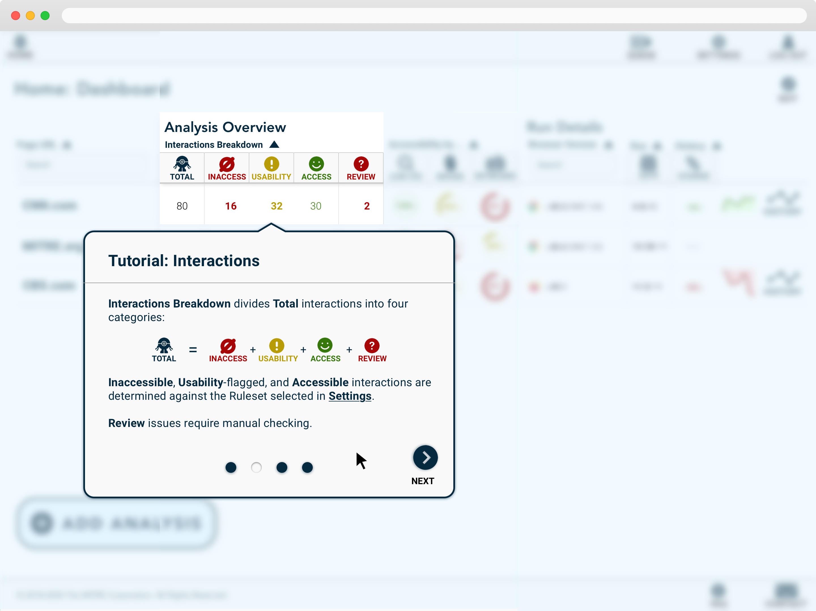

Slide 22
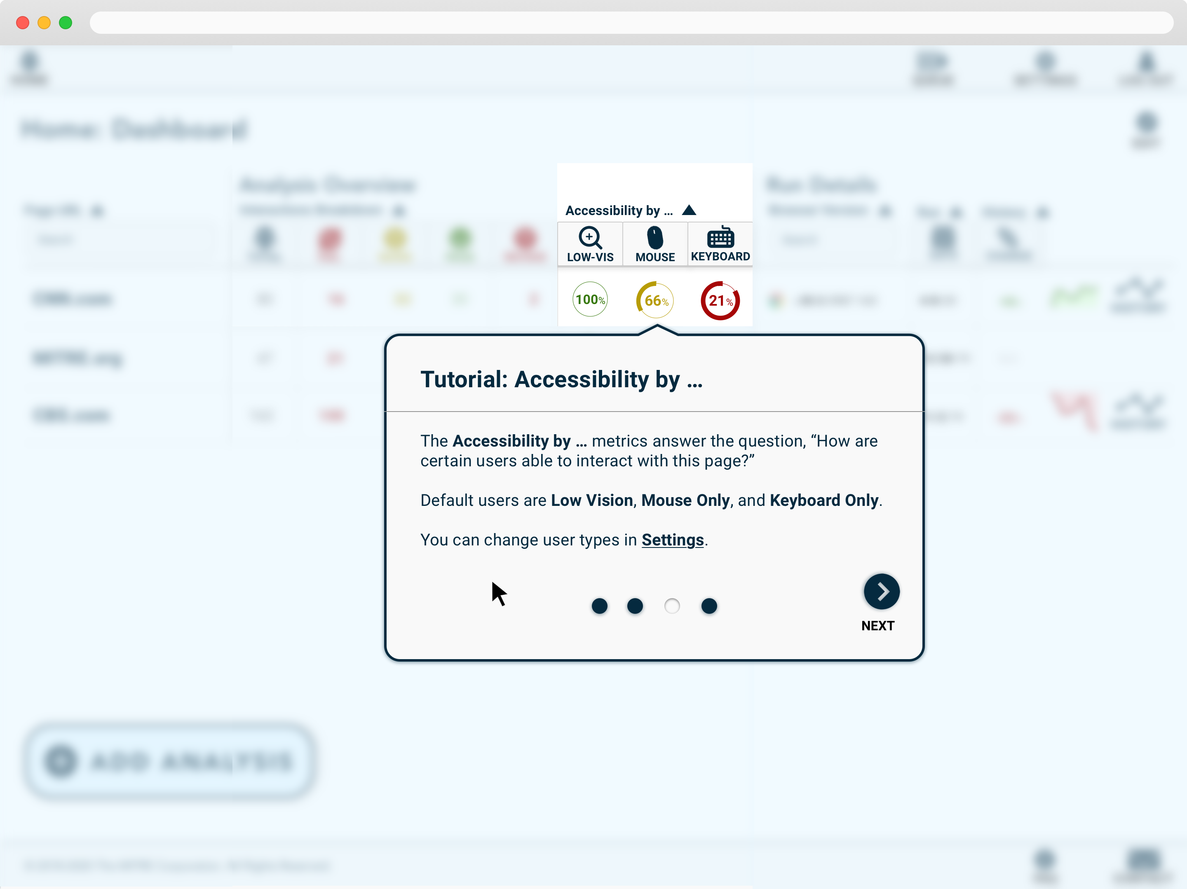

Slide 23
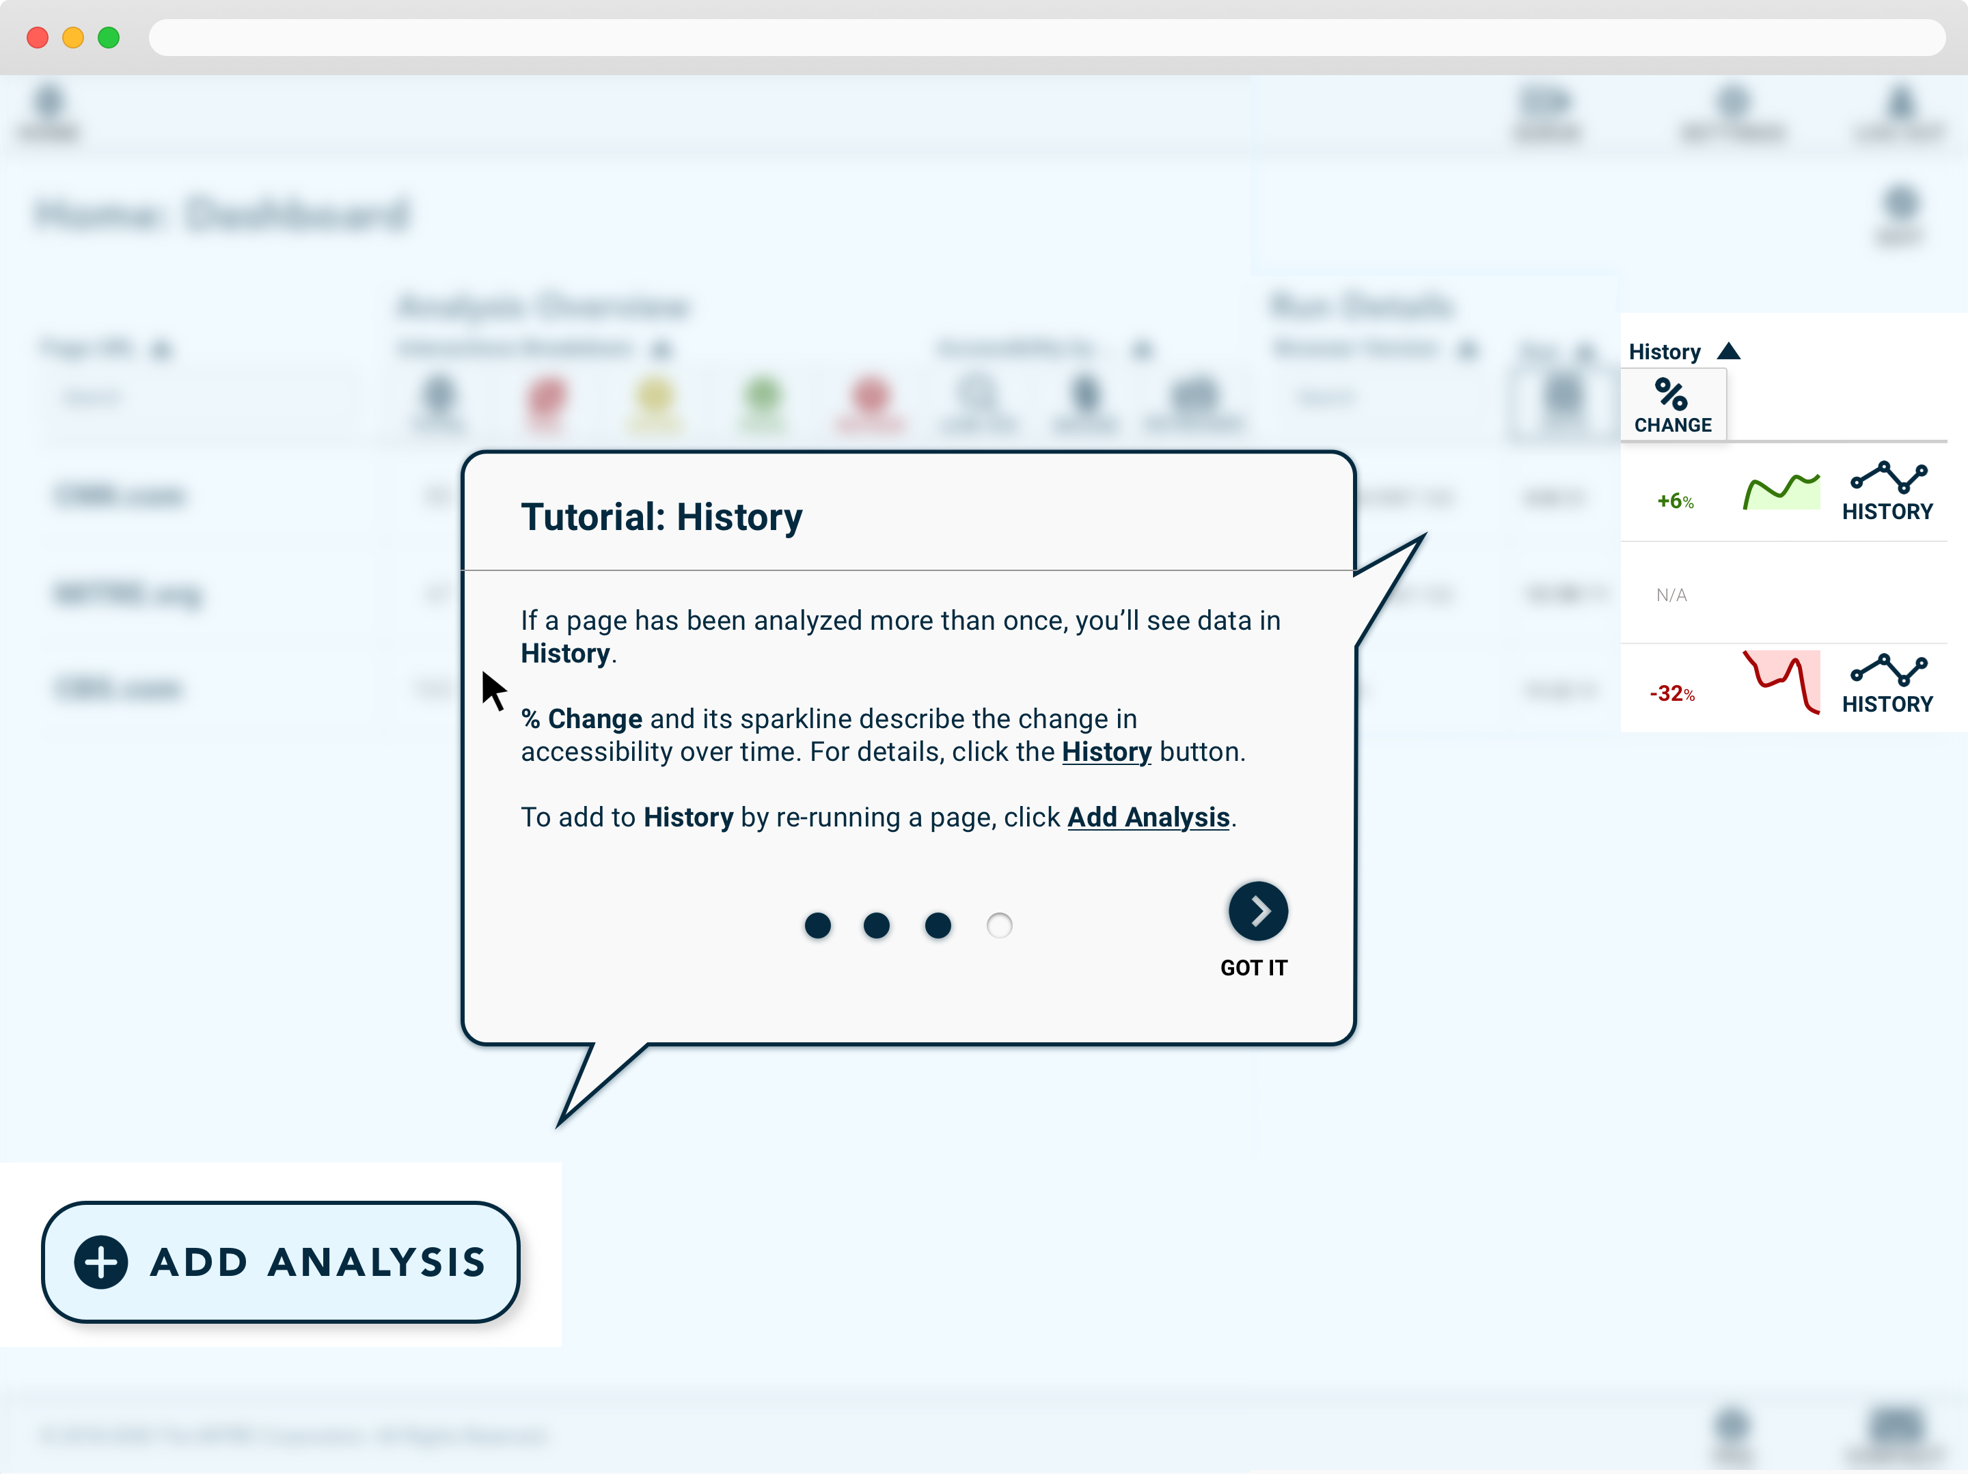

Slide 24
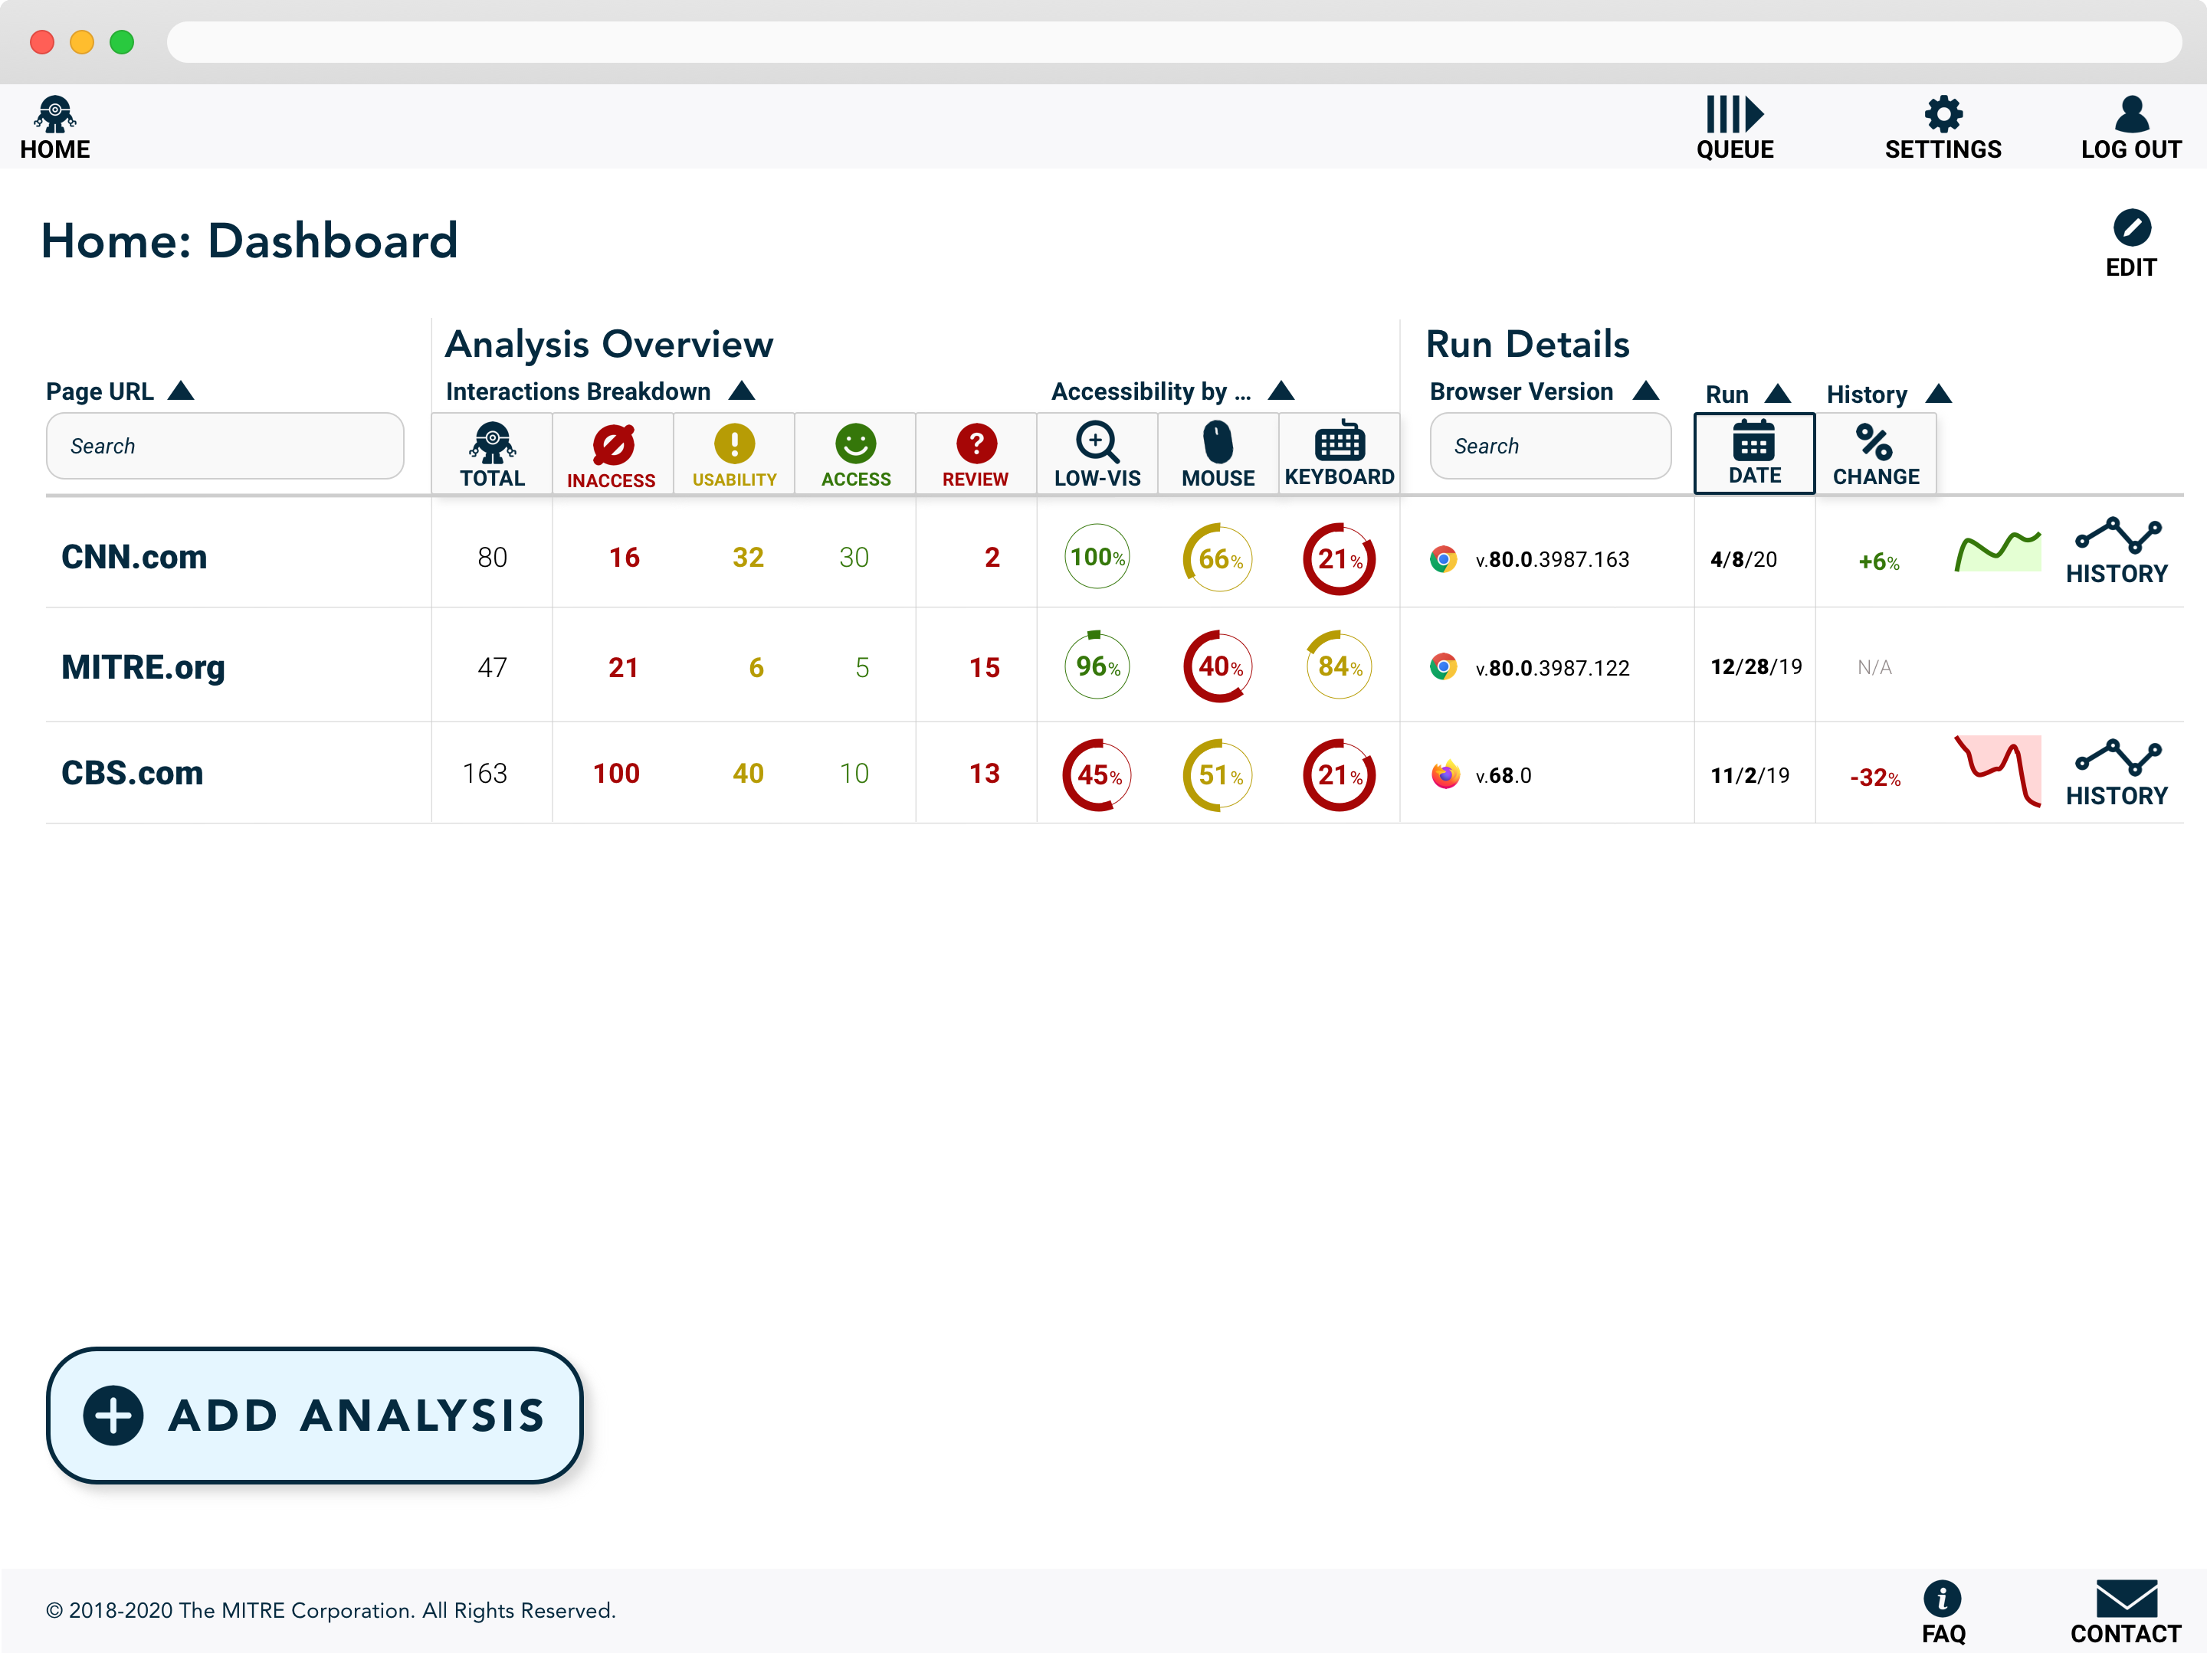

Slide 25
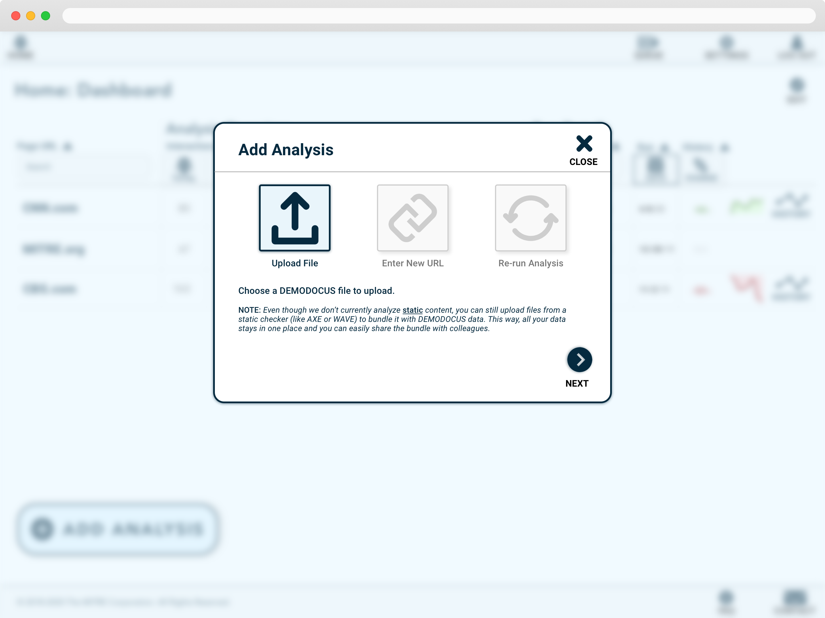

Slide 27
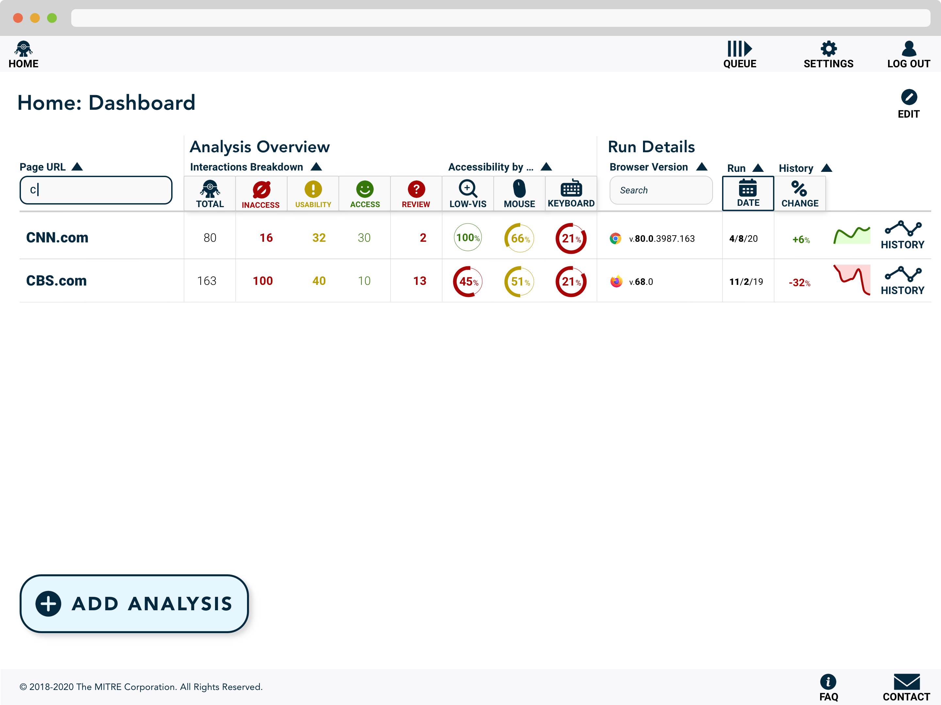

Slide 28
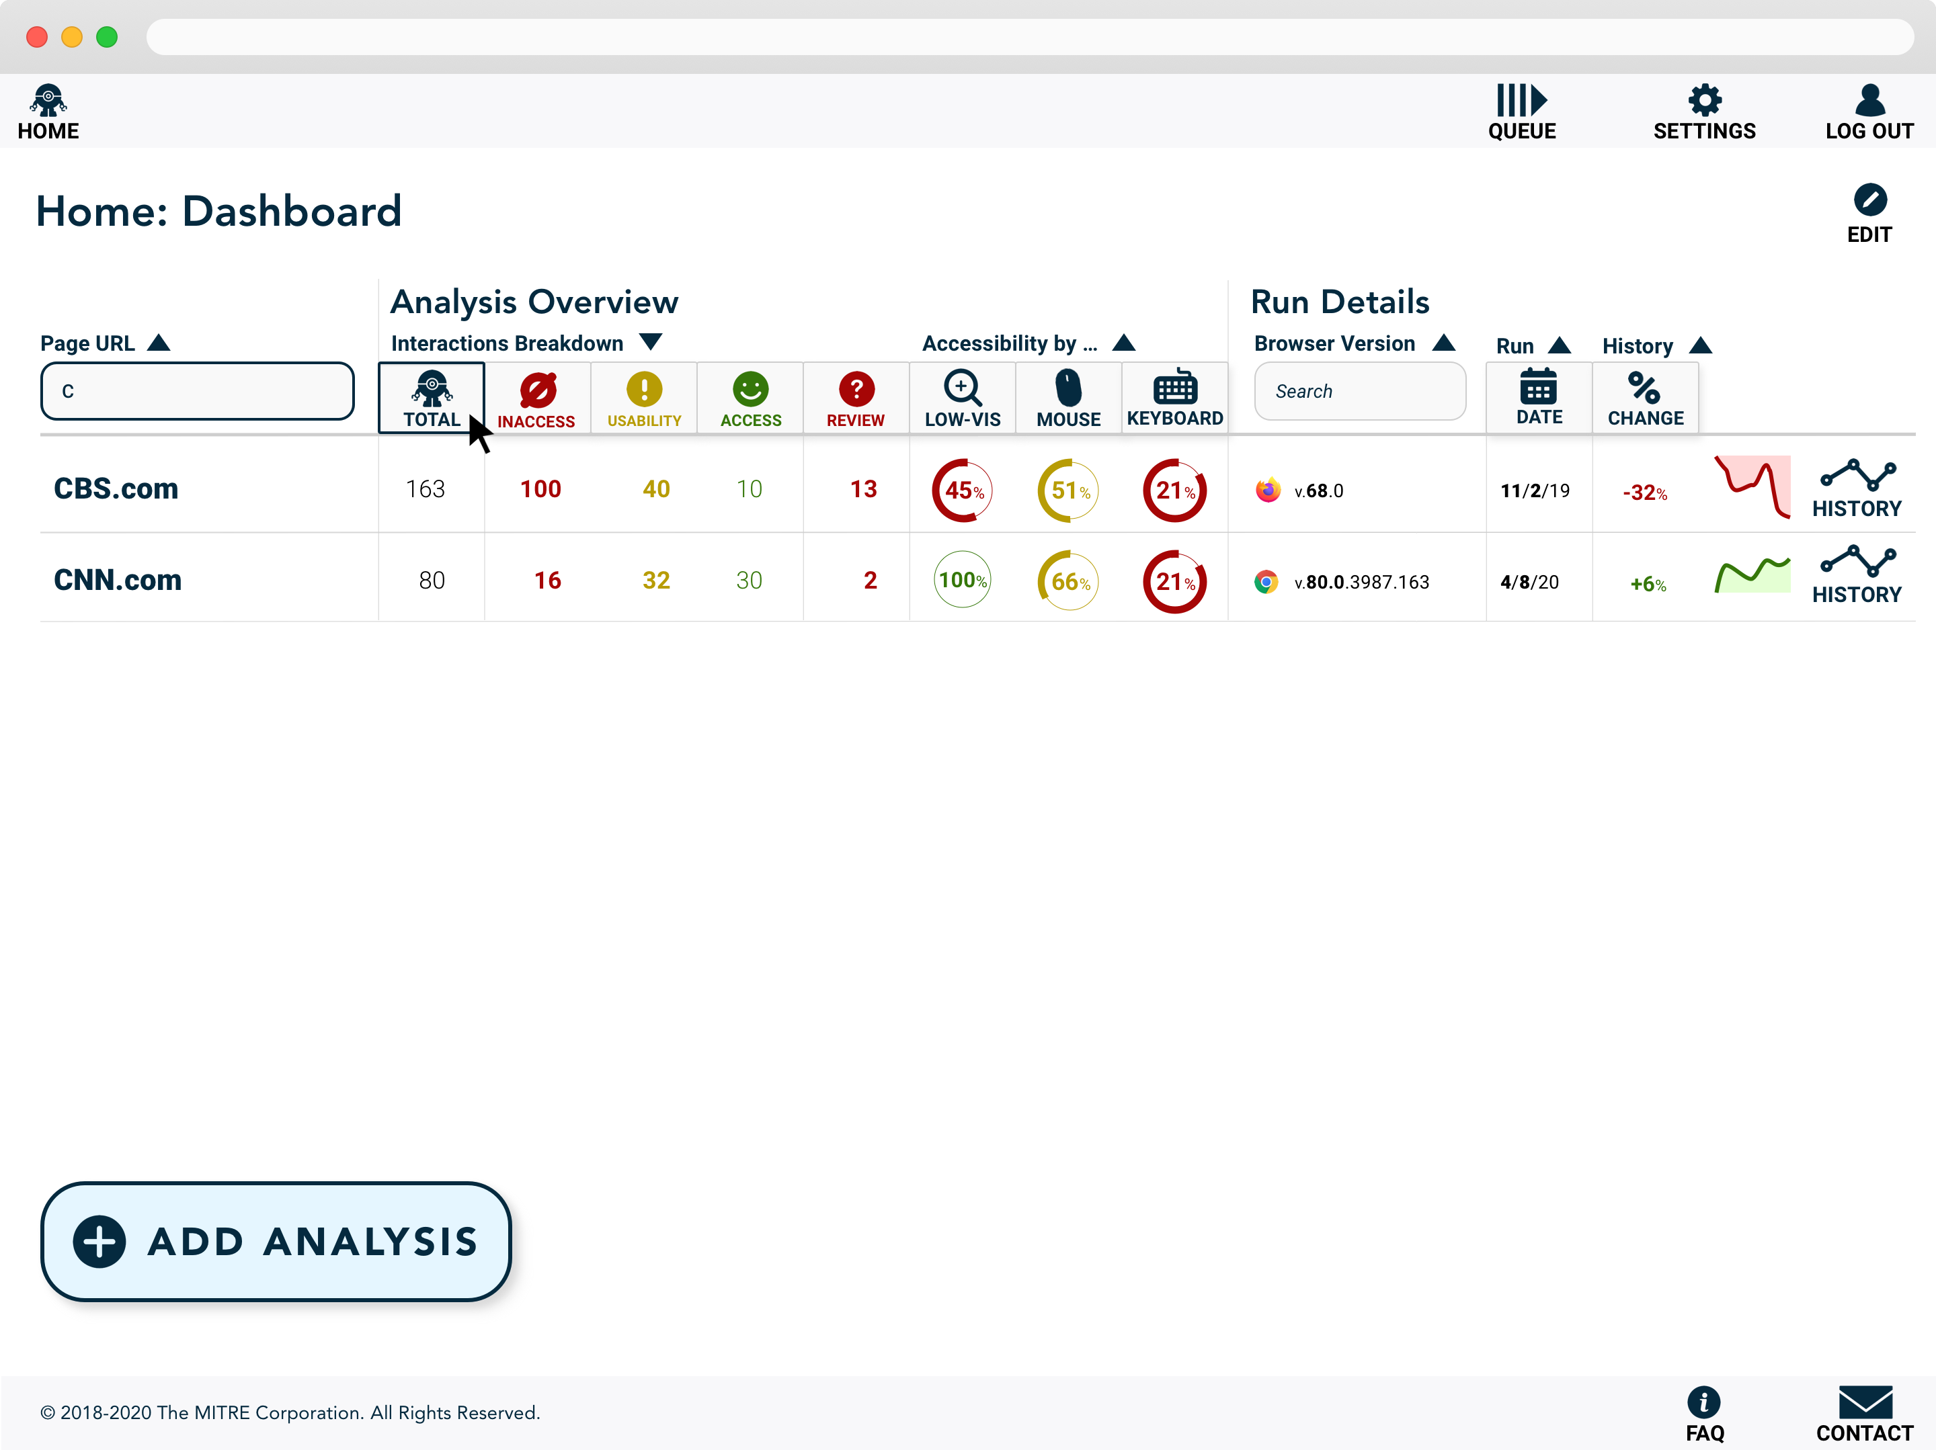

Slide 29
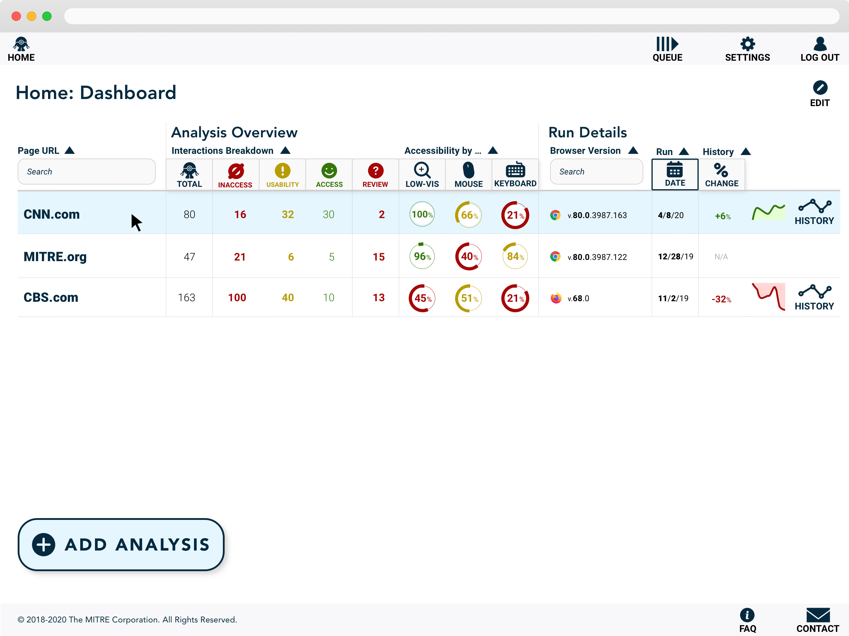

Slide 30
Exploring the Results
© 2020 THE MITRE CORPORATION. ALL RIGHTS RESERVED.

Slide 31
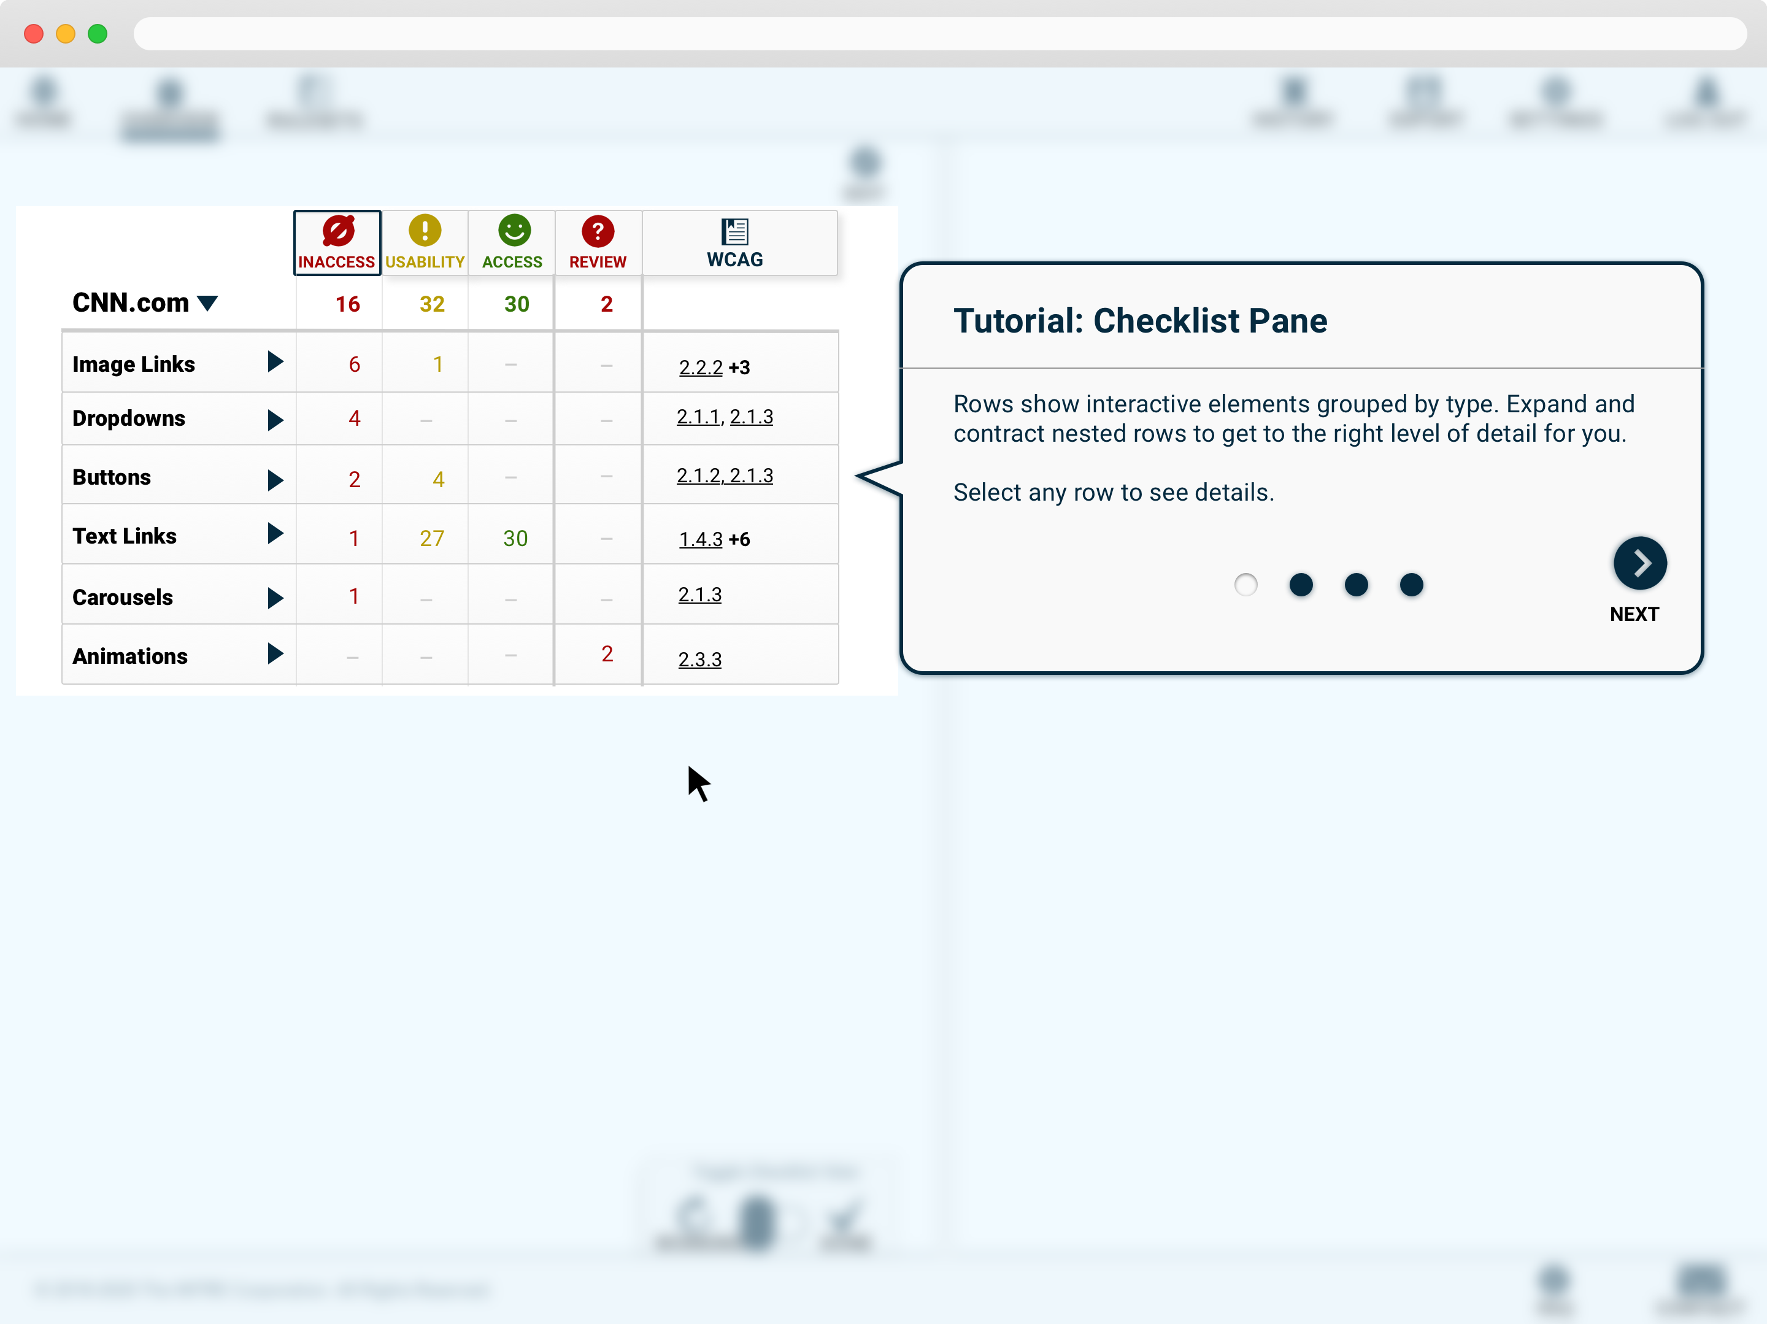

Slide 32
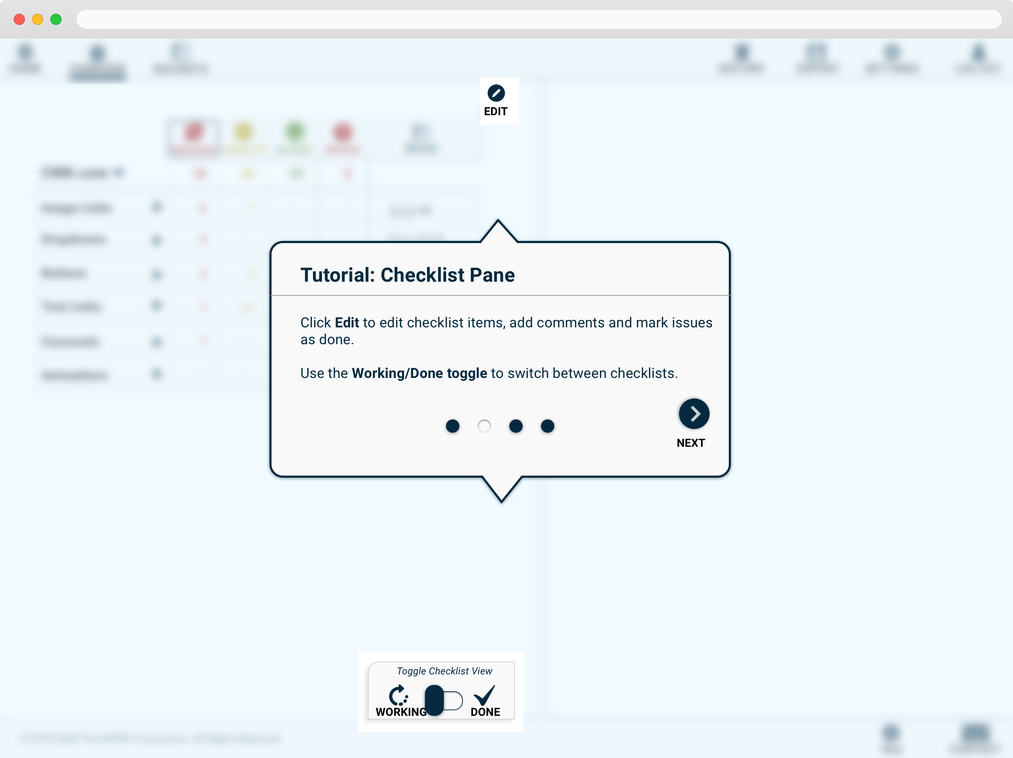

Slide 33
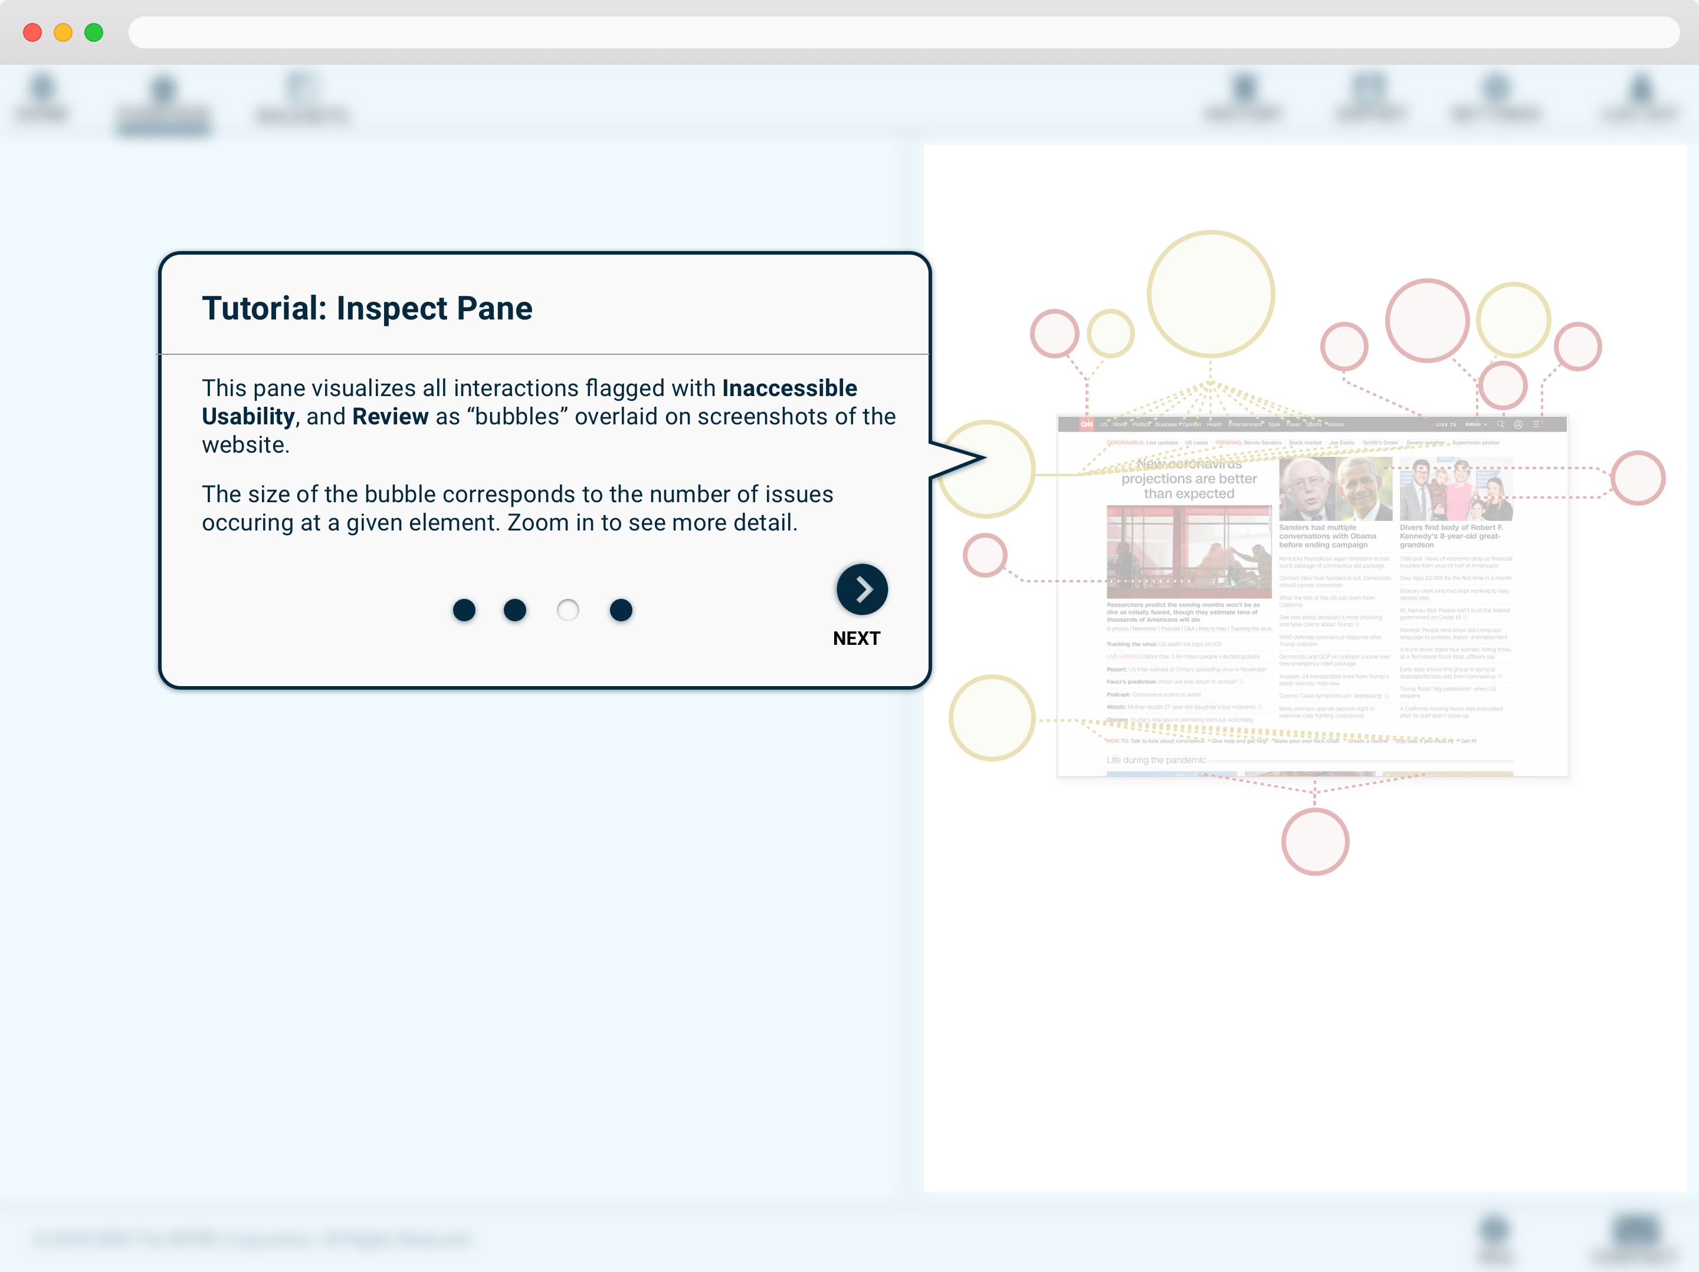

Slide 34
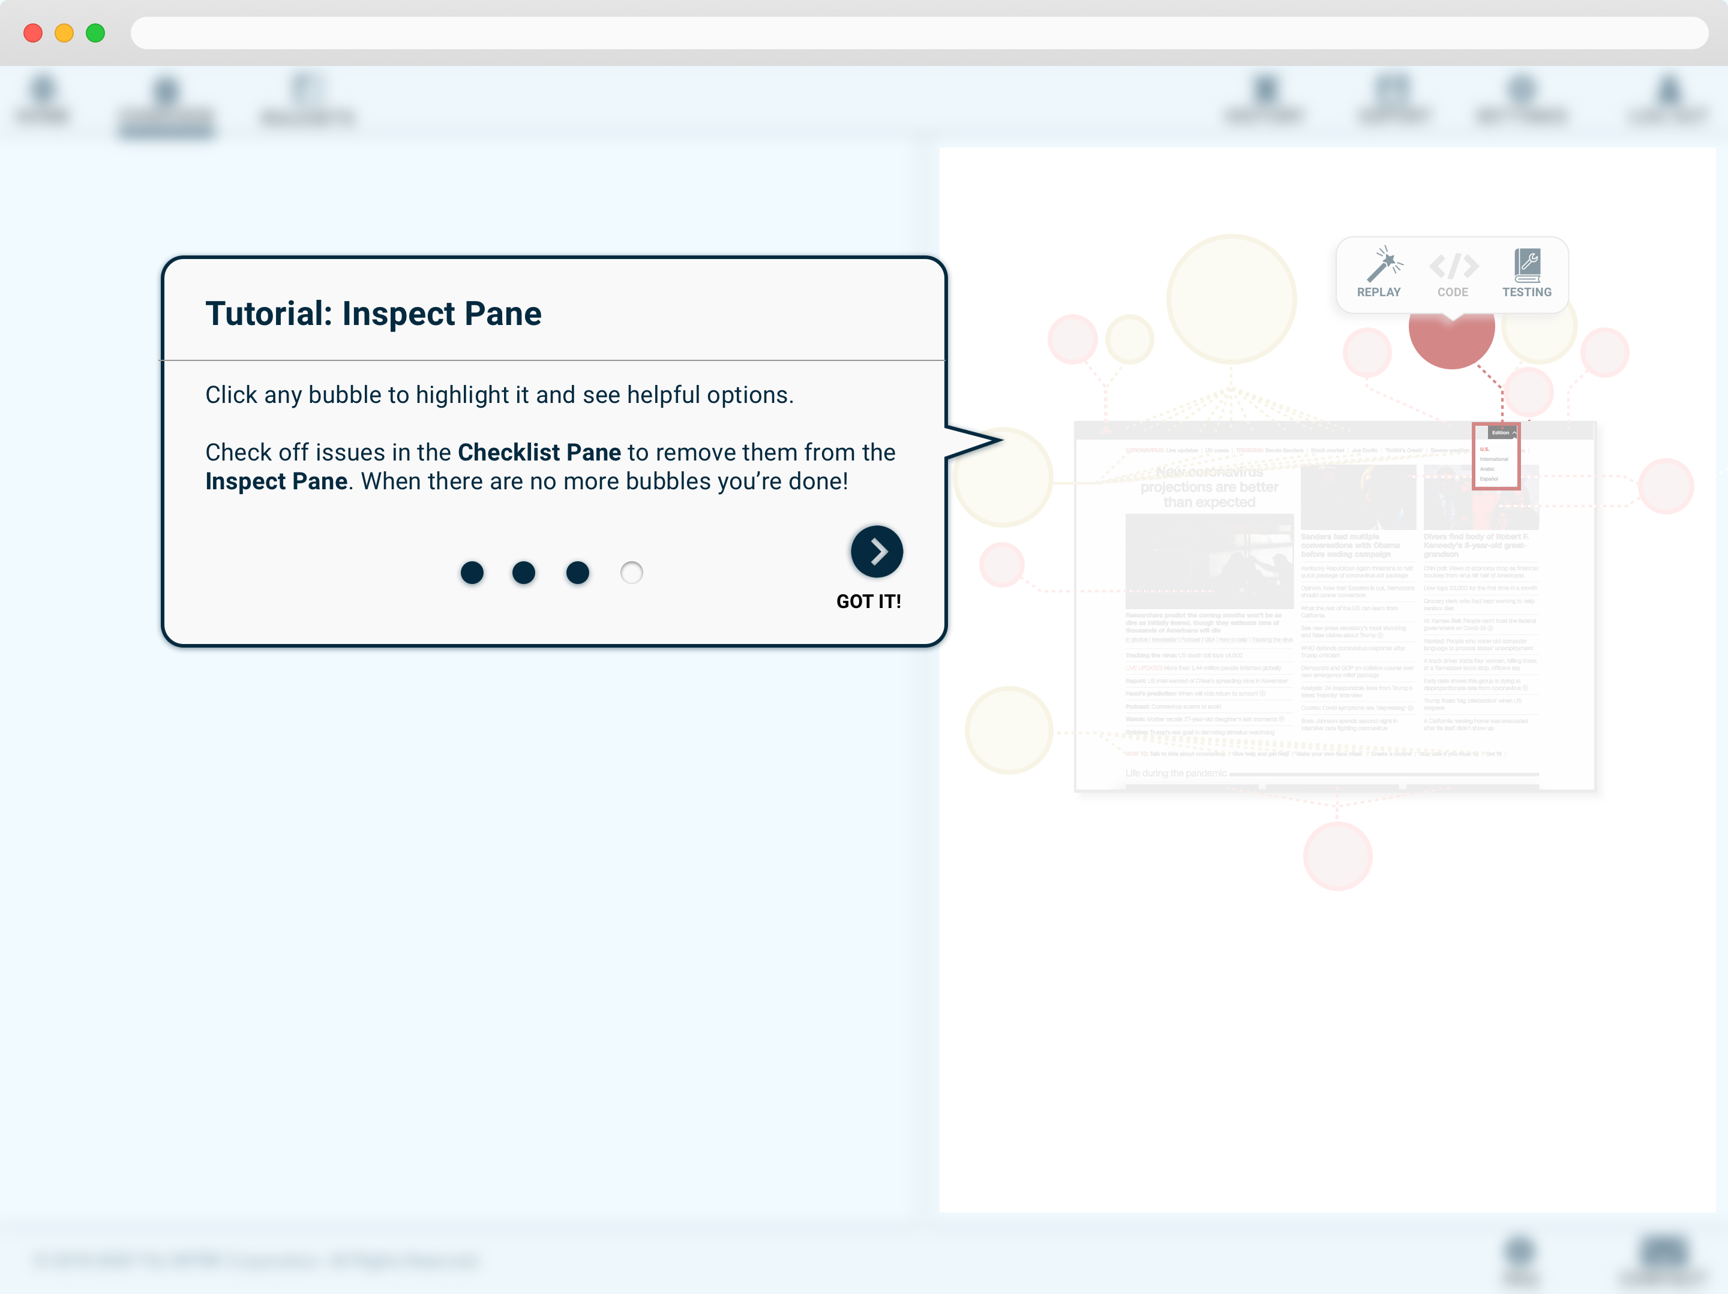

Slide 35
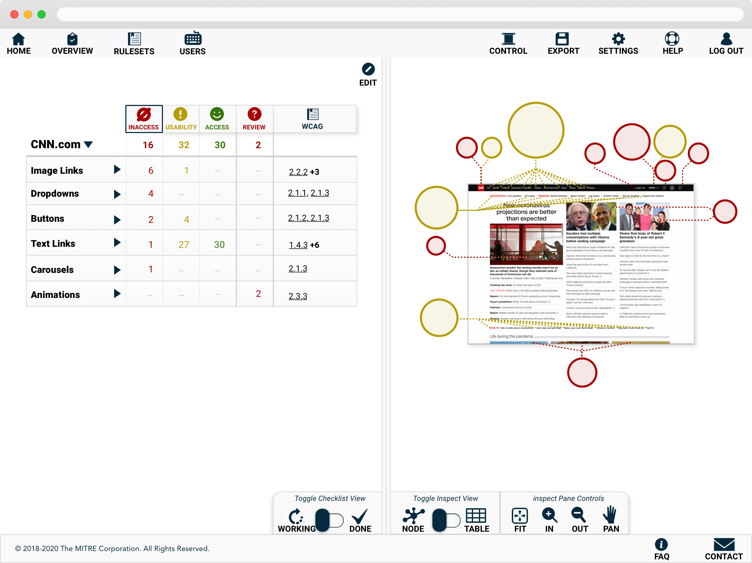

Slide 36


Slide 37
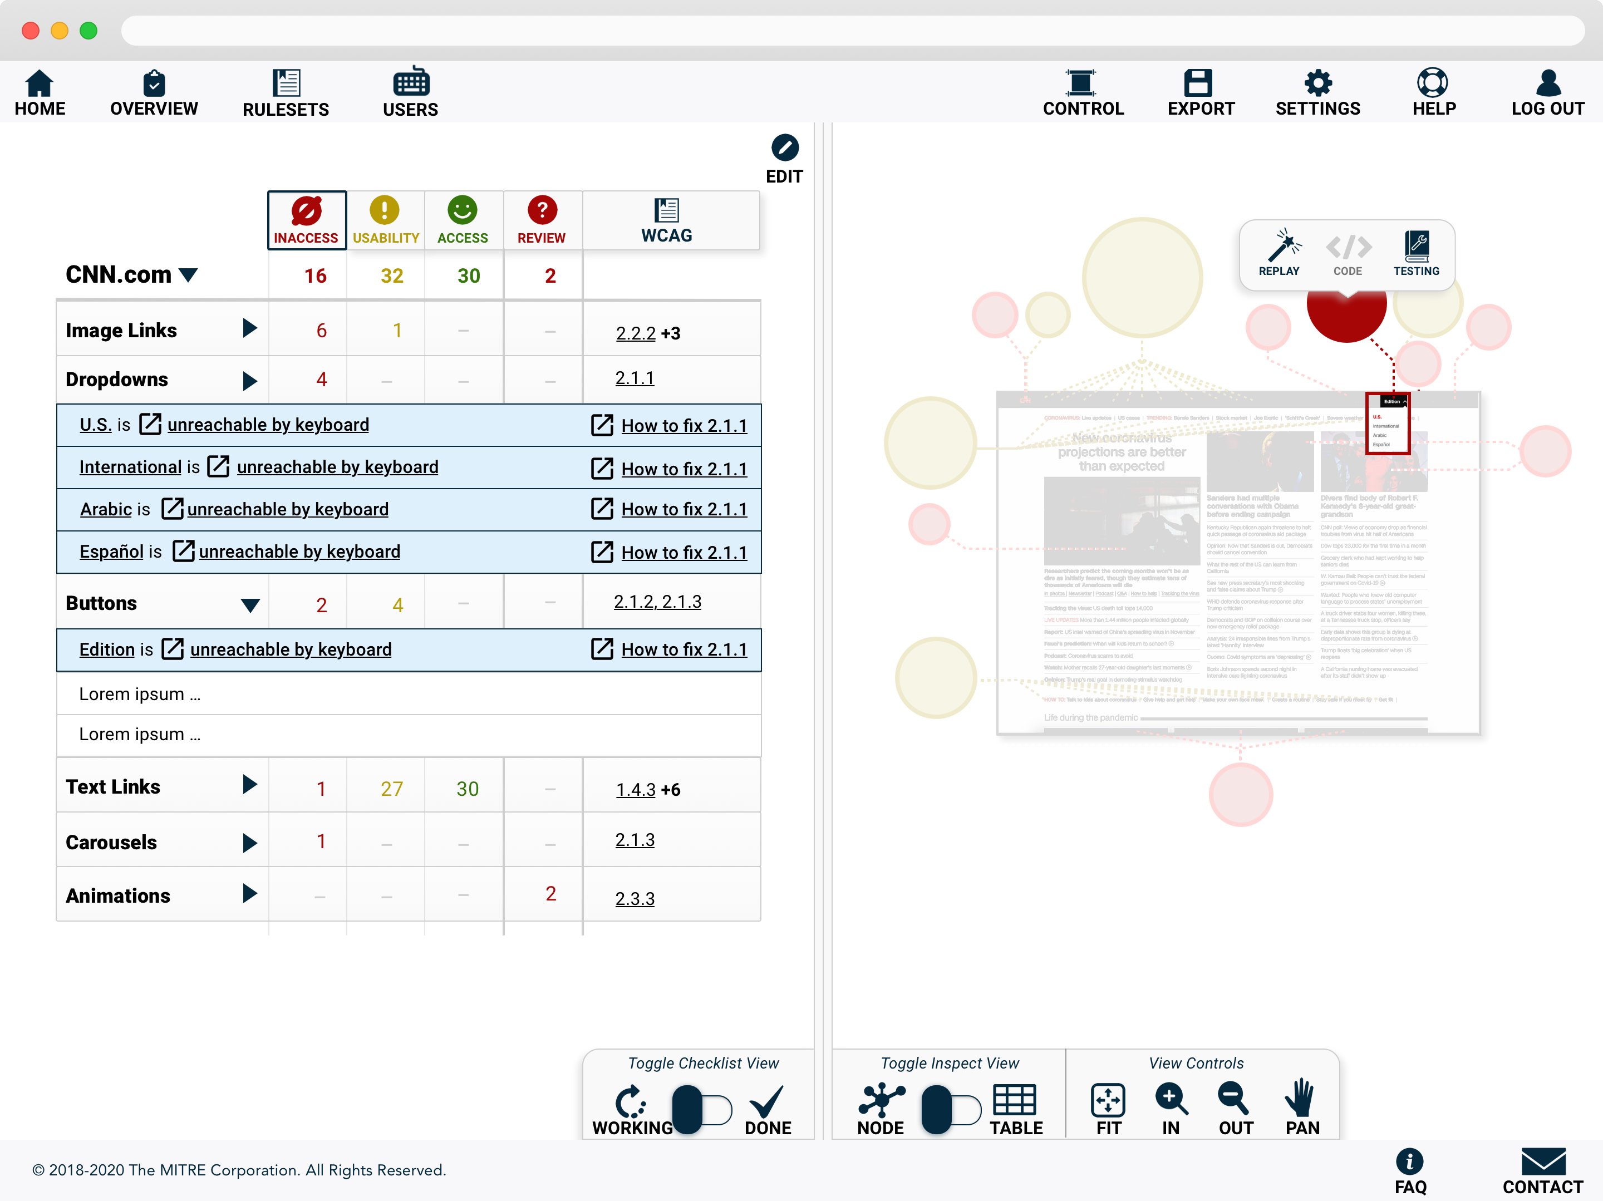

Slide 38
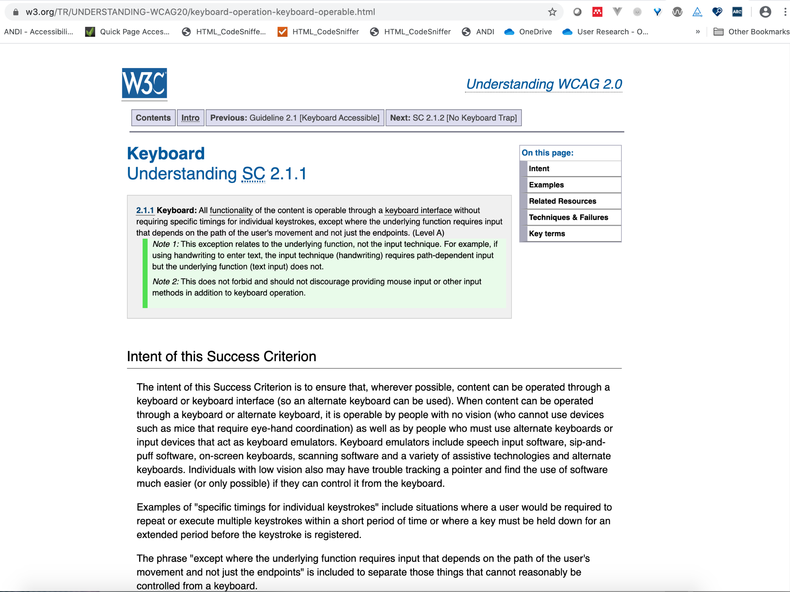

Slide 39
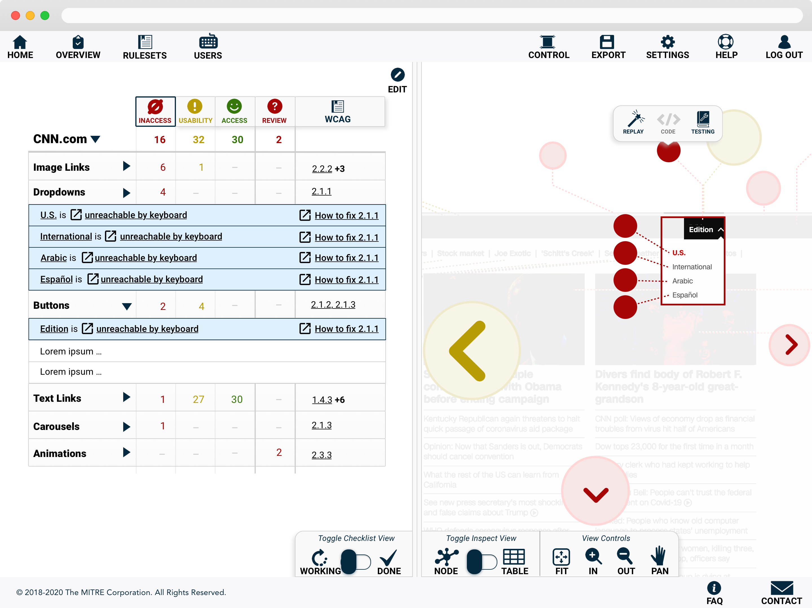

Slide 40
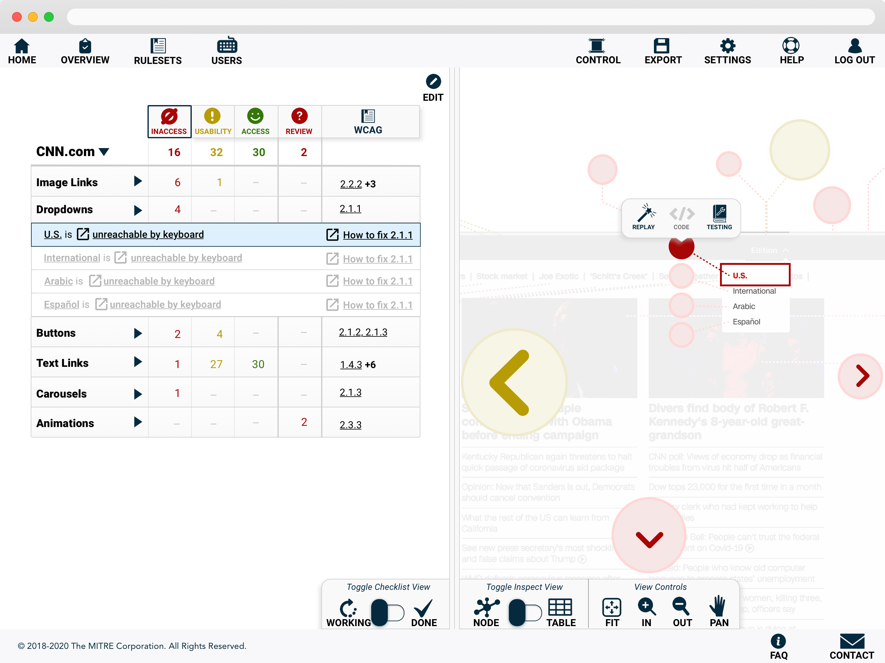

Slide 41
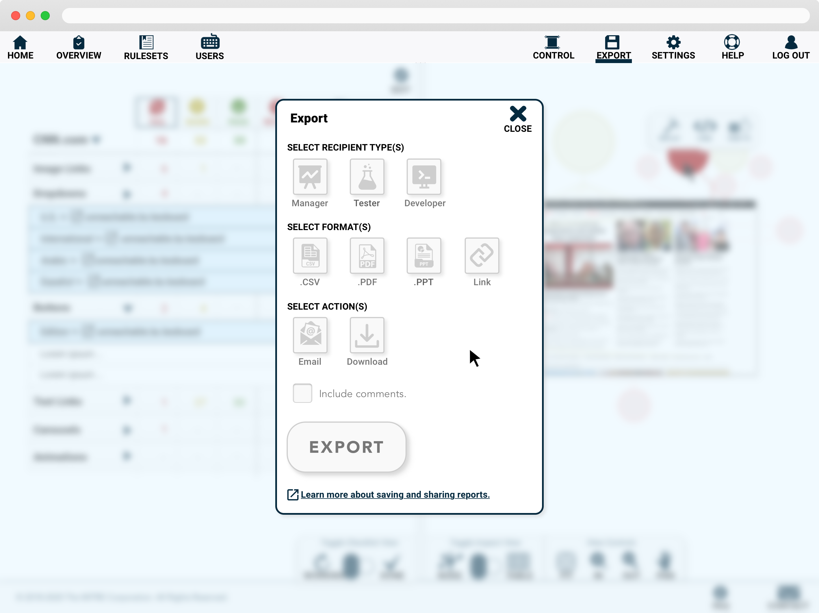

Slide 42
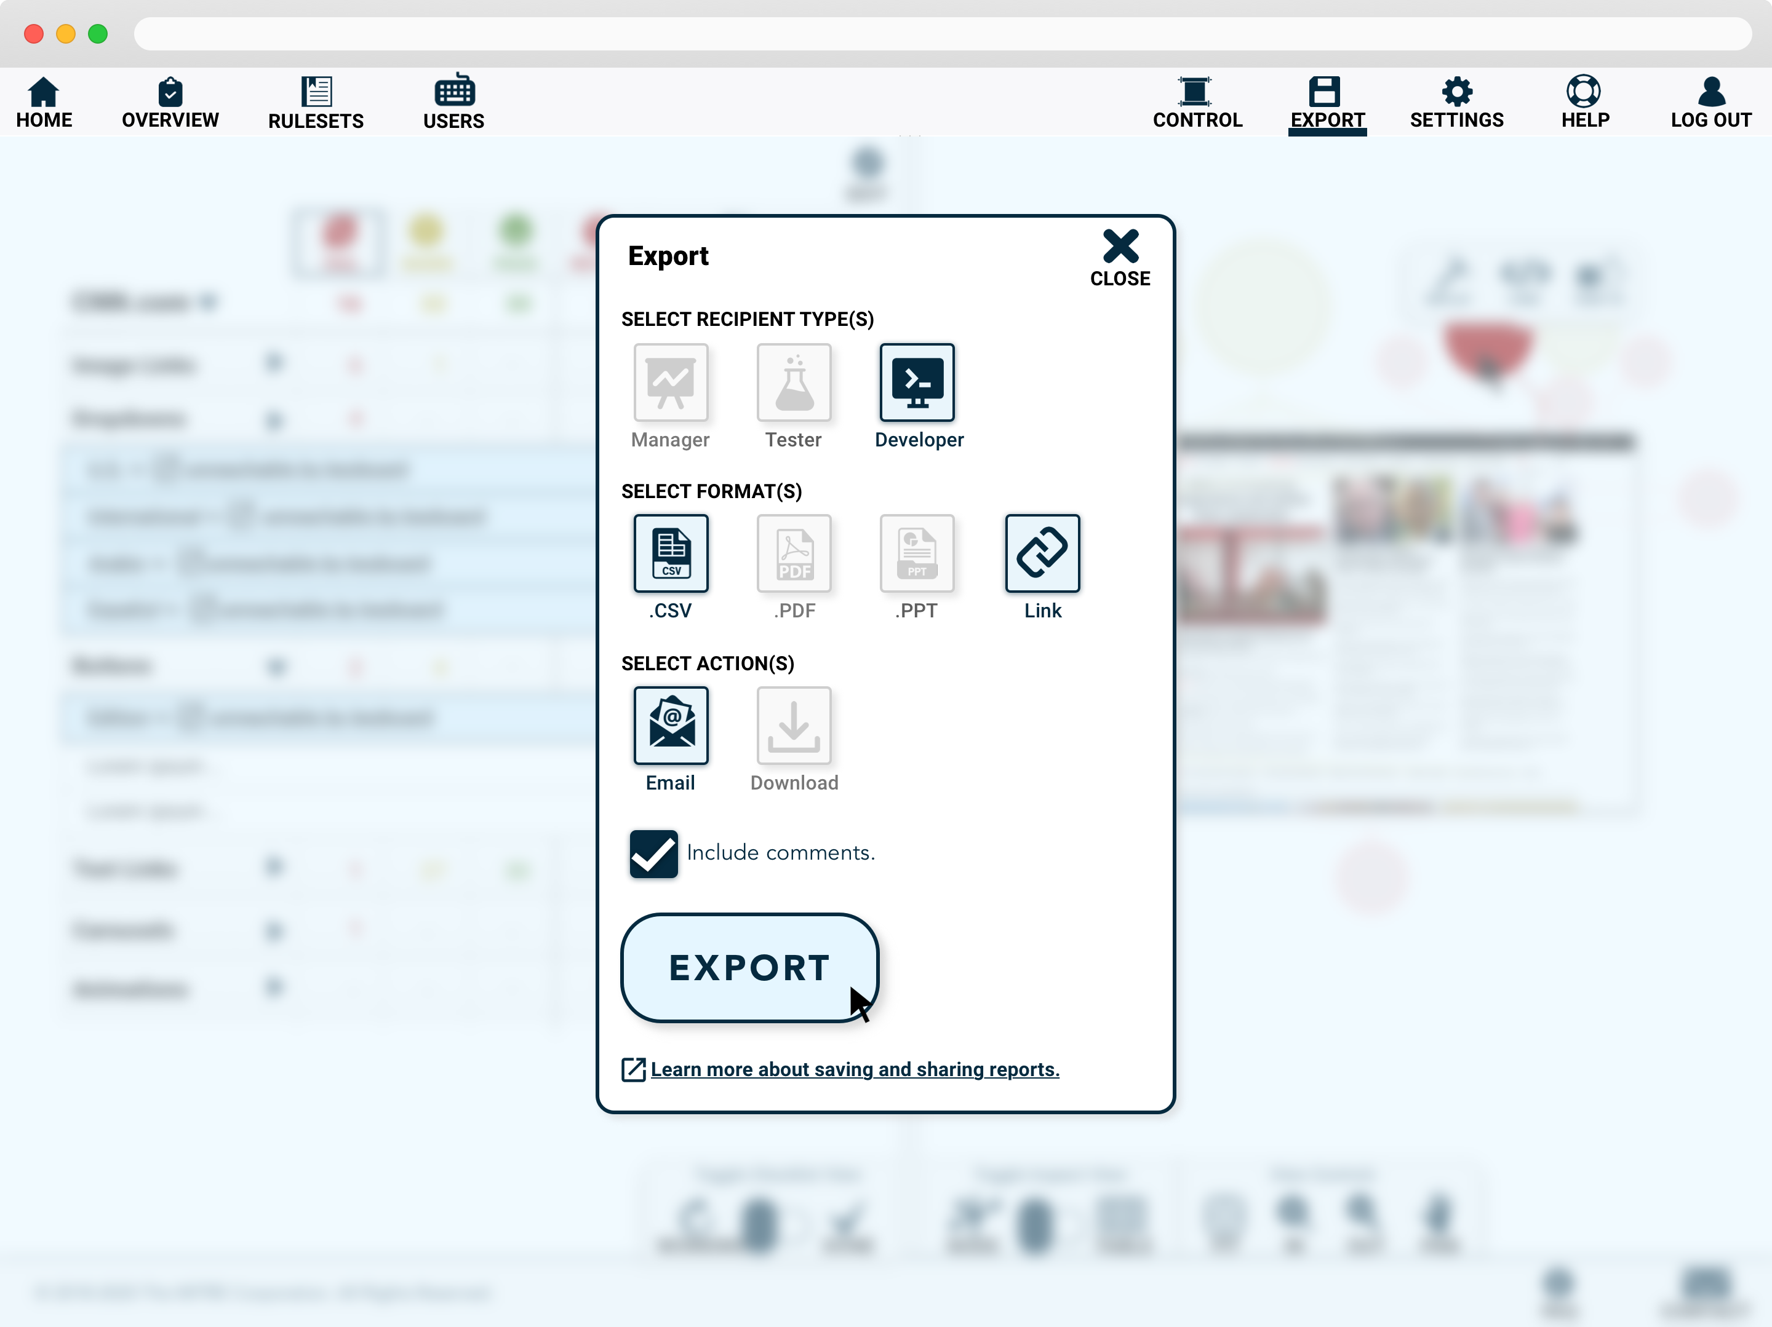

Slide 43
Name
email@mitre.org
@TwitterHandle
linkedin.com/in/firstnamelastname
© 2020 THE MITRE CORPORATION. ALL RIGHTS RESERVED.

